Slide 1

VORTICITY vs VORTEX
Mechanical Engineering Department
Bekir Kağan YAVUZ
2018913026

Slide 2
Index
Introduction
Kinematic Descriptions
Vorticity
Vortex
Conclusion
References

Slide 3
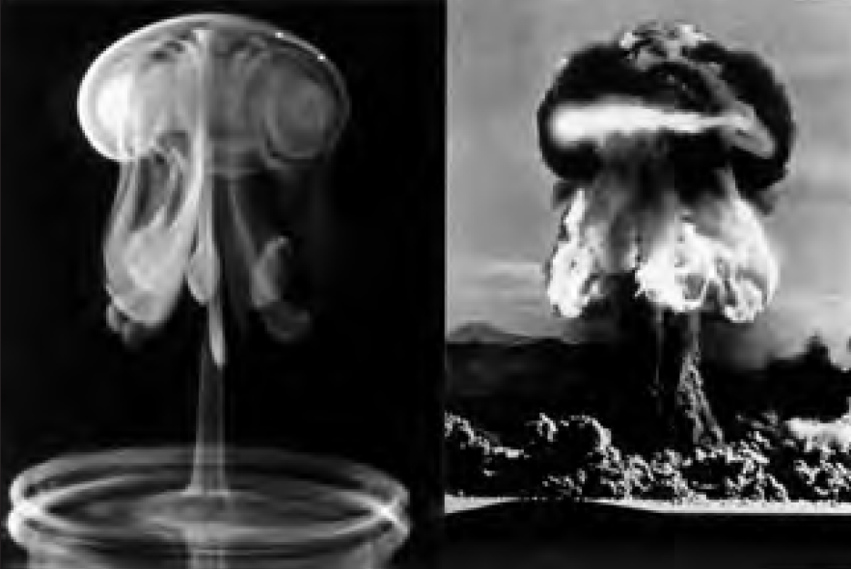
Introduction
A strong similarity of two images [1]:
due to some «fluid mechanics» terms:
density, buoyancy, shock wave, control volume, CFD, flow visualization
Vortex Ring:
mini-turnado of concentrated vorticity with the ends of the tornado looping around to close on itself
Inverted Water Drop after impacting a pool
Above-ground Nuclear Test in Nevada, 1957
wrt. the Kinematics’ Laws:
Vortex ring will carry the fluid in a direction toward the top

Slide 4
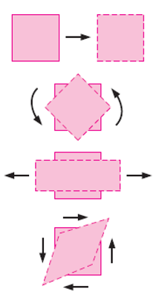
Kinematic Descriptions
In fluid mechanics as in solid mechanics, there are 4 types of motion or deformation:
Translation
Rotation
Linear Strain
Shear Strain
In fluid mechanics, the difference is that, these motions usually occur simultaneously.
Because fluid may be in constant motion, it is preferable to describe them in rates:
Velocity
Angular Velocity (to be focused)
Linear Strain Rate
Shear Strain Rate
To be useful in the calculation, they are expressed in terms of velocity and derivatives of velocity.

Slide 5
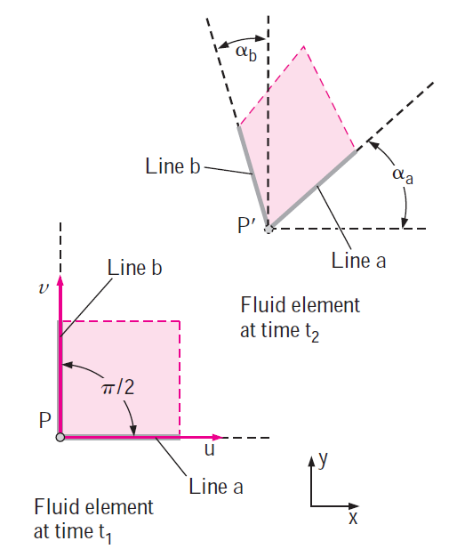
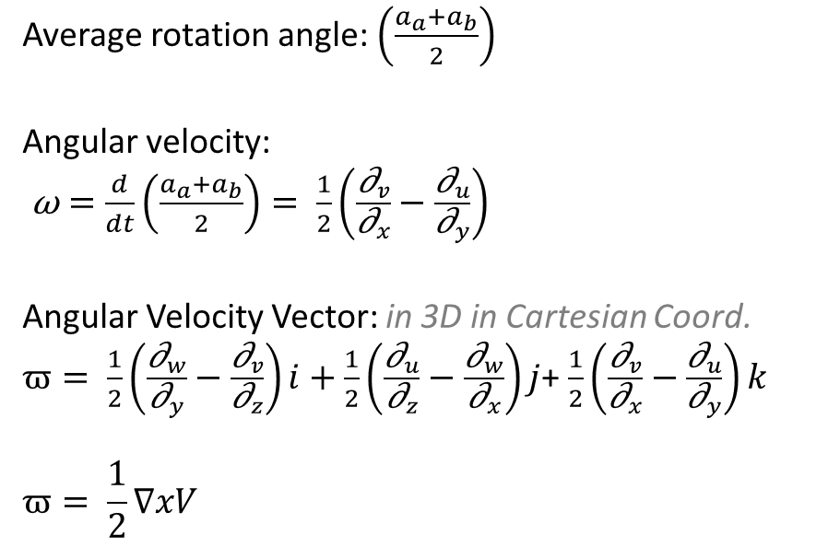
Kinematic Descriptions
b) Angular velocity (rate of rotation) at a point:
the average angular velocity of two initially perpendicular lines that intersects at a point as below:
Average rotation angle: $\left(\frac{a_{a}+a_{b}}{2}\right)$
Angular velocity:
$\text{ω}=\frac{d}{dt}\left(\frac{a_{a}+a_{b}}{2}\right)= \frac{1}{2}\left(\frac{{\text{∂}}_{v}}{{\text{∂}}_{x}}−\frac{{\text{∂}}_{u}}{{\text{∂}}_{y}}\right)$
Angular Velocity Vector: in 3D in Cartesian Coord.
$ϖ= \frac{1}{2}\left(\frac{{\text{∂}}_{w}}{{\text{∂}}_{y}}−\frac{{\text{∂}}_{v}}{{\text{∂}}_{z}}\right)i+\frac{1}{2}\left(\frac{{\text{∂}}_{u}}{{\text{∂}}_{z}}−\frac{{\text{∂}}_{w}}{{\text{∂}}_{x}}\right)j$+ $\frac{1}{2}\left(\frac{{\text{∂}}_{v}}{{\text{∂}}_{x}}−\frac{{\text{∂}}_{u}}{{\text{∂}}_{y}}\right)k$
$$ϖ= \frac{1}{2}∇xV$$

Slide 6
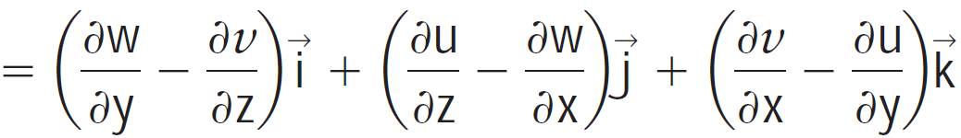
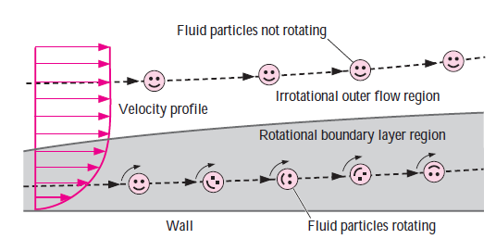
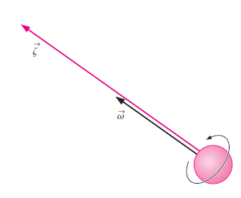
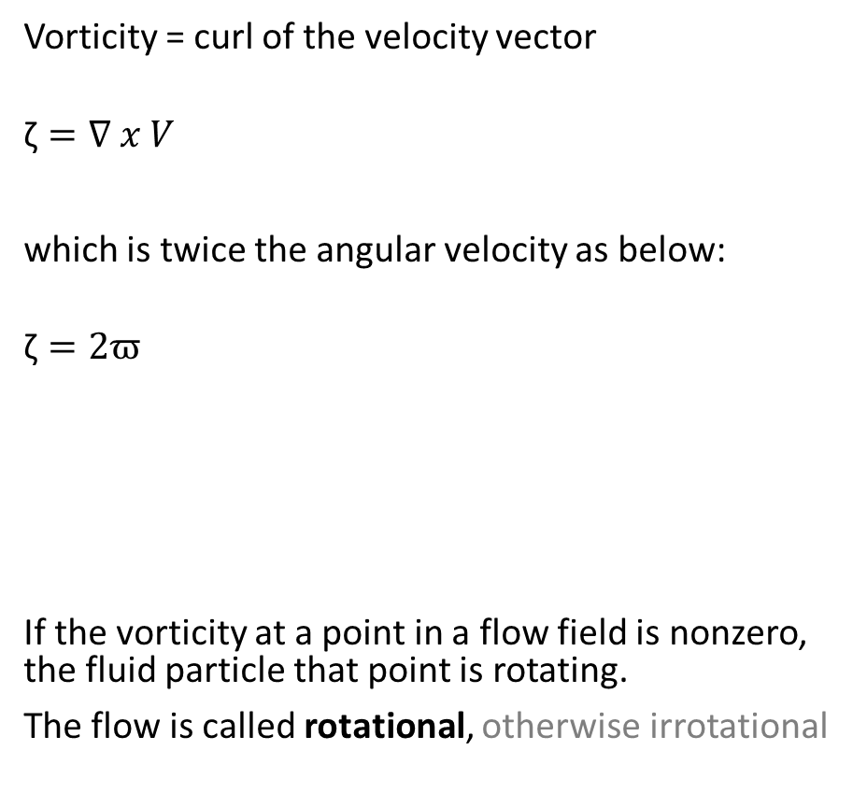
Vorticity, ζ
Vorticity = curl of the velocity vector
$$\text{ζ}=∇ x V$$
which is twice the angular velocity as below:
$$\text{ζ}=2ϖ$$
If the vorticity at a point in a flow field is nonzero, the fluid particle that point is rotating.
The flow is called rotational, otherwise irrotational
Rotation of fluid is related with wakes, turbomachinery, heat transfer and boundary layers as below:

Slide 7
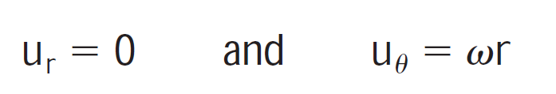
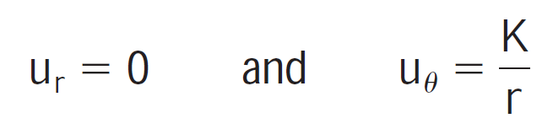
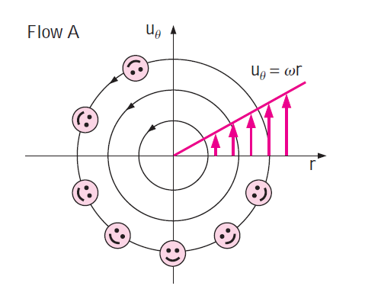
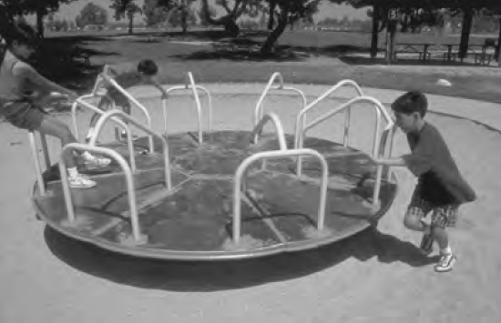
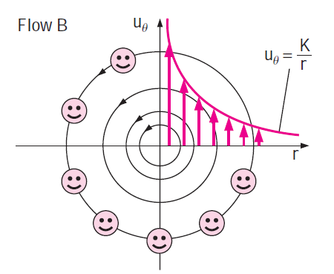
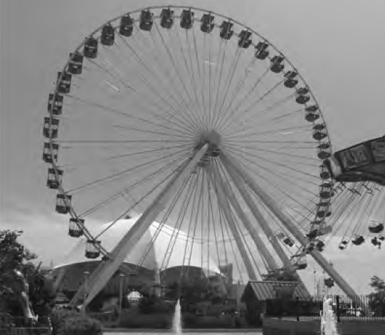


Vorticity, ζ, comparison of two circular flows
A) Solid Body Rotation B) Line-Vortex
VORTICITY (ROTATIONAL) NO VORTICITY (IRROTATIONAL)

Slide 8
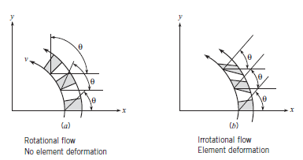


Vortex
A local structure in a fluid flow characterized by a concentration of vorticity (i.e., fluid particle spin or rotation) in a tubular core with circular streamlines around the core axis.
Types
a. Rotational / Forced Vortex : Vortex formed by a turbomachine (pump or jet engines)
b. Natural / Irrotational / Free Vortex : Peripheral velocity is inverse of the distance from the radius (ie. kitchen sink after suddenly opening the valve or Tornado). The circumferential velocity varies inversely with r, so the velocity decreases with increasing radius [3] as below:
Where C is constant

Slide 9
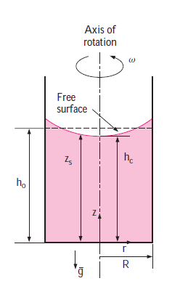
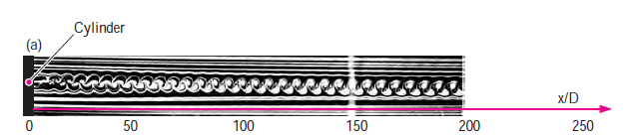
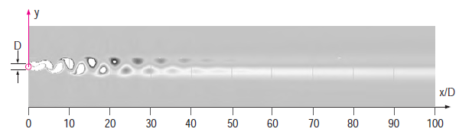
Vortex
Forced Vortex Motion
Kármán Vortex Street
Smoke streaklines introduced by a smoke wire at just downstream of the cylinder in the wake of a circular cylinder
Vortices shed in an alternating pattern from the cylinder, the smoke collects into a clearly defined pattern called a Kármán vortex street.
Water is rotated about its axis, the fluid is forced outward as a result of the so-called centrifugal force, and the free surface of the liquid becomes concave.
An instantaneous snapshot of vorticity contours produced by CFD

Slide 10
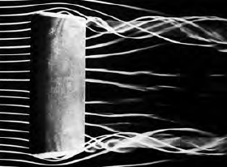
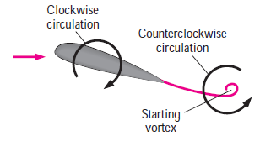
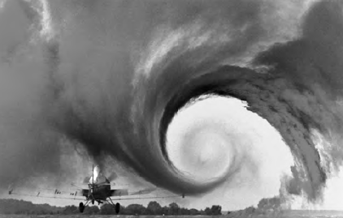
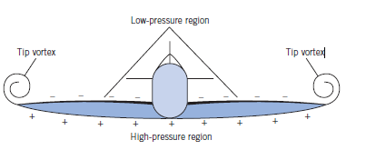
Vortex
Starting Vortex
Tip Vortex
Trailing vortices from a rectangular wing with vortex cores leaving the trailing edge at the tips.
The pressure difference between the lower surface (high-pressure region) and the upper surface (low-pressure region) drives the fluid at the tips upward while the fluid is swept toward the back because of the relative motion between the fluid and the wing. This results in a swirling motion that spirals along the flow, called the tip vortex.
A small plane flies through smoky air to illustrate the tip vortices produced at the tips of the wing.
Shortly after a sudden increase in angle of attack, a counterclockwise starting vortex is shed from the airfoil, while clockwise circulation appears around the airfoil, causing lift to be generated.
From the potential flow theory and the observed phenomenon.

Slide 11
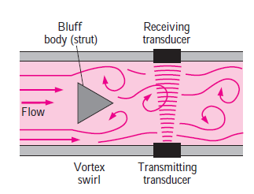
Vortex Flowmeters
The Strouhal Number, defined as St = f.d/V,
where:
f is the vortex shedding frequency,
d is the characteristic diameter or width of the obstruction,
V is the velocity of the flow impinging on the obstruction, also remains constant in this case, provided that the flow velocity is high enough
Flow rate can be determined by generating vortices in the flow by placing an obstruction along the flow and measuring the shedding frequency.
The flow measurement devices that work on this principle are called vortex flowmeters.
Accurately at Reynolds numbers from 104 to 107 (usually 11 percent over a wide range of flow rates).

Slide 12
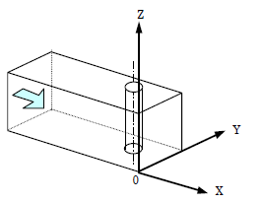
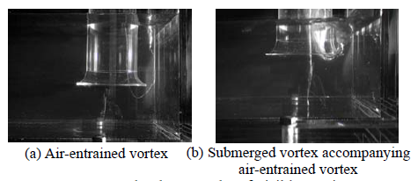
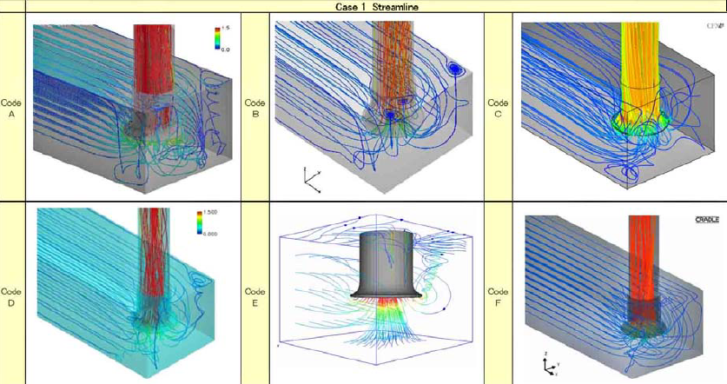
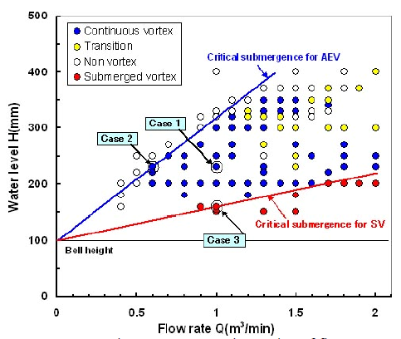
Vortex: An example from industry
The need to contain construction costs led to reduction in the size of the pump sump systems.
Such smaller systems can be affected by vortices such as air entrained or submerged.

Slide 13
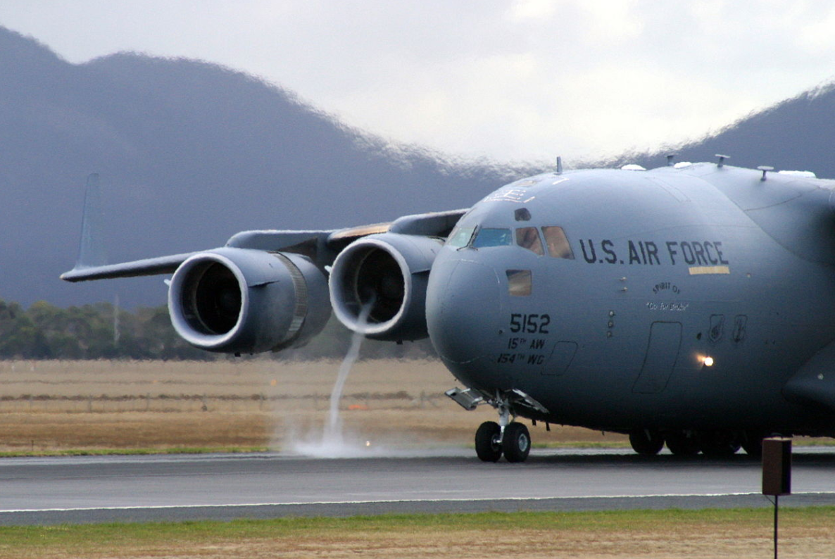
Conclusion
Vorticity is just a vector that defines the tendency of the fluid to rotate
Vortex flow is the special flow phenomenon that involves non-zero vorticity and rotating about an axis
Sometimes there might be vorticity, but not vortex flow, as it is a vector quantity at an instantaneous point.
The visible core of a vortex formed when the plane uses high engine power at slow speed on a wet runway (reverse thrust)

Slide 14
Q&A
THANK YOU

Slide 15
References
Y. A. Çengel and J. M. Cimbala. Fluid Mechanics 3rd Ed., McGraw-Hill Education, 2010
C. T. Crowe, et al. Engineering Fluid Mechanics 9th Ed., John Wiley & Sons Inc., 2009
P. Pritchard and J. Leylegian, Introduction to Fluid Mechanics 8th Ed., John Wiley & Sons Inc., 2011

