Slide 1



NFPA CFPS
Kağan YAVUZ
Mechanical Engineer, PhDc
2024 07

Slide 2
INDEX
Definition
Exam Details
Eligibility
Renewal
General Misconceptions
Fire Protection Handbook
Sections
Bonus

Slide 3


DEFINITION
CFPS (The Certified Fire Protection Specialist) is a certification provided by the NFPA Certification Department in the U.S.A.
The purpose - to test and recognize test taker's knowledge of fire protection, fire prevention, and fire safety.
CFPS is an American National Standards Institute (ANSI) Approved certification.

Slide 4


CFPS EXAM CONDITIONS
CFPS Exam is of 3 hours duration.
The Exam has 100 multiple-choice questions.
This is an Open book Exam: NFPA Fire Protection Handbook
Test takers can opt either Paper based or Computer Based Exam
via
Exam centers are available in many countries.

Slide 5

ELIGIBILITY
Any one of the following criteria is acceptable:
Bachelor's or Master's degree in a Fire Protection or related discipline from an accredited college or university with 2 years of relevant experience.
Associate Degree in Fire Engineering and related field or Bachelor's or Master's degree in any unrelated field with 4 years of relevant experience.
High school diploma or equivalent with 6 years of relevant work experience in fire safety.

Slide 6

RENEWAL
Recertification - every three years.
Renewal - is required annually with a renewal fees.

Slide 7

GENERAL MISCONCEPTIONS
NOT
Need to read all the content: 3400 Pages
Need to memorize all the portions.
Need to attempt to make all 100 questions correct: Make you stressful
Need to refer many books other than Fire Protection Handbook.
Need to require very long preparation
Be shameful to ask for help and guidance (ie. LinkedIn networks).

Slide 8
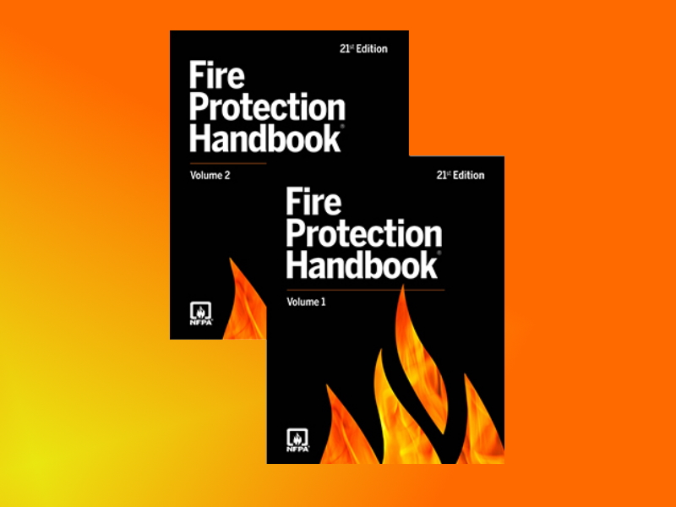
FIRE PROTECTION HANDBOOK (FPH)
The Handbook has two volumes with 3,500 pages.
The content covers almost entire spectrum of fire protection.
Written by 254 leading experts.
As per latest update in NFPA's website the book cost ~ $300

Slide 9

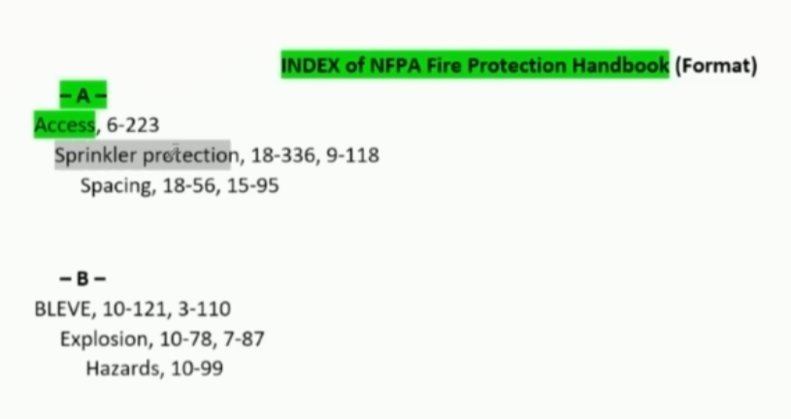
USING INDEX
82 pages in Total

Slide 10
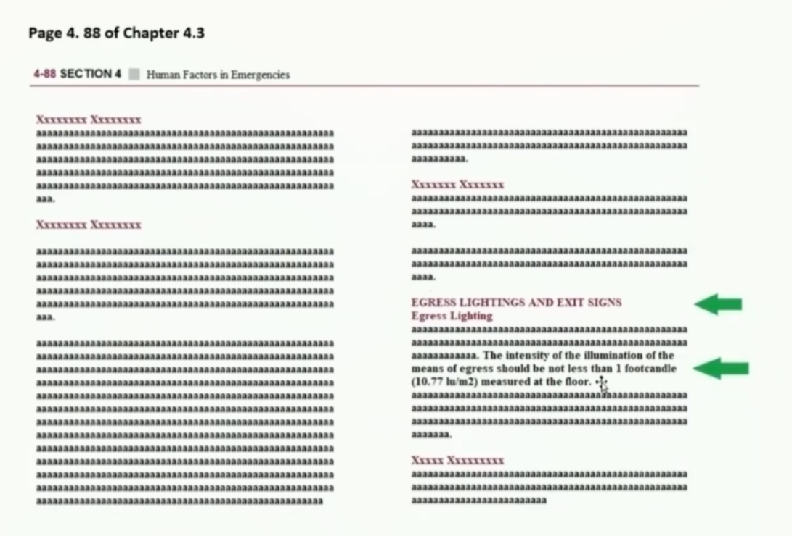
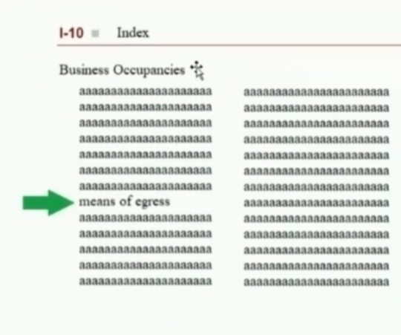
USING INDEX

Slide 11
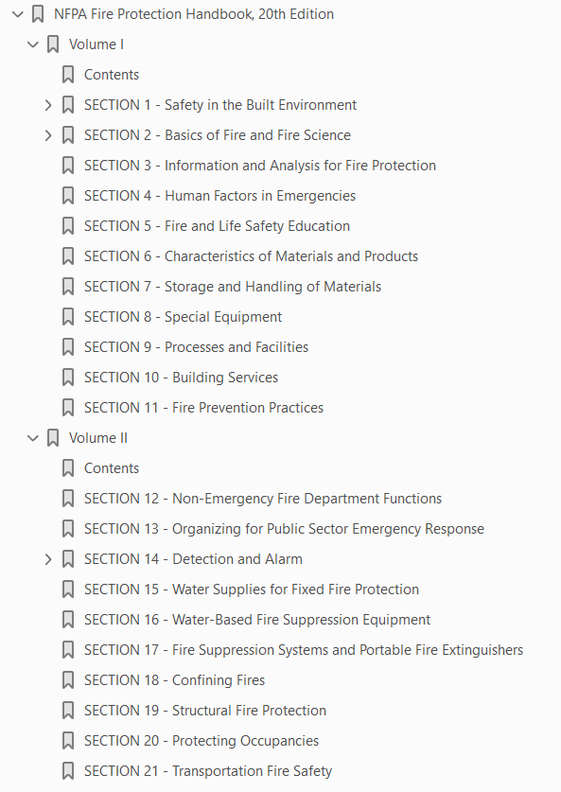
FIRE PROTECTION HANDBOOK (FPH)
The Handbook has:
21 Sections
211 Chapters

Slide 12
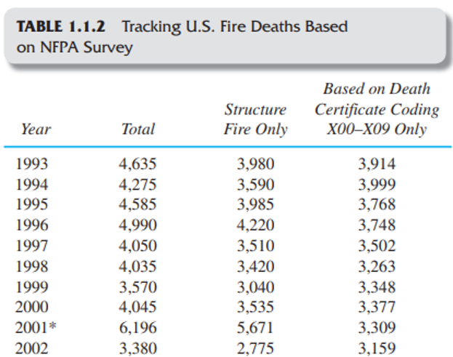
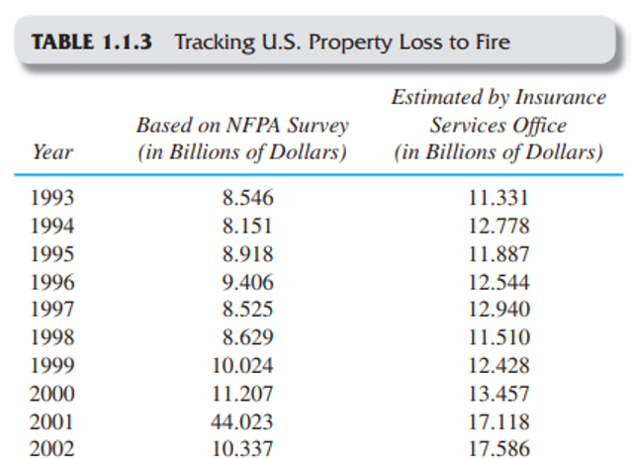
SECTION 1 - Safety in the Built Environment

Slide 13
SECTION 2 - Basics of Fire and Fire Science

Slide 14
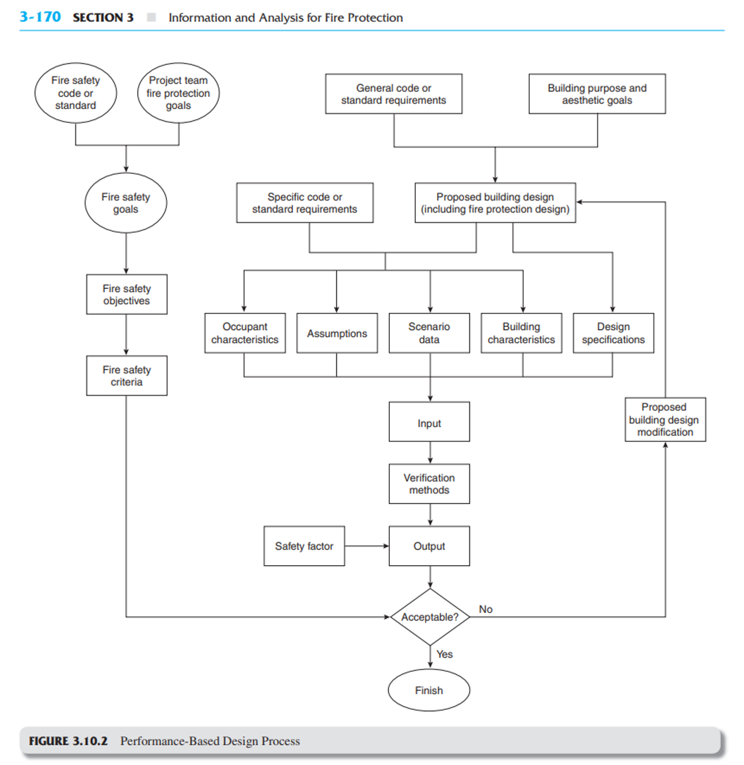


SECTION 3 - Information and Analysis for Fire Protection

Slide 15
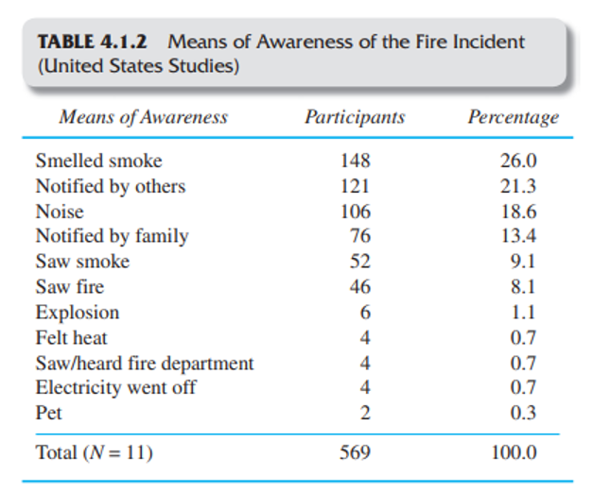
SECTION 4 - Human Factors in Emergencies

Slide 16
SECTION 6 - Characteristics of Materials and Products

Slide 17
SECTION 7 - Storage and Handling of Materials

Slide 18
SECTION 8 - Special Equipment

Slide 19
SECTION 9 - Processes and Facilities

Slide 20
SECTION 10 - Building Services

Slide 21
SECTION 11 - Fire Prevention Practices

Slide 22
SECTION 12 - Non-Emergency Fire Department Functions

Slide 23
SECTION 13 - Organizing for Public Sector Emergency Response

Slide 24
SECTION 14 - Detection and Alarm

Slide 25
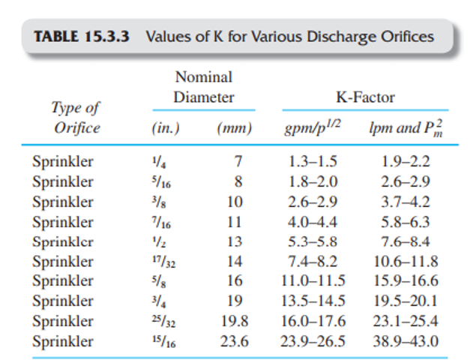
SECTION 15 - Water Supplies for Fixed Fire Protection

Slide 26
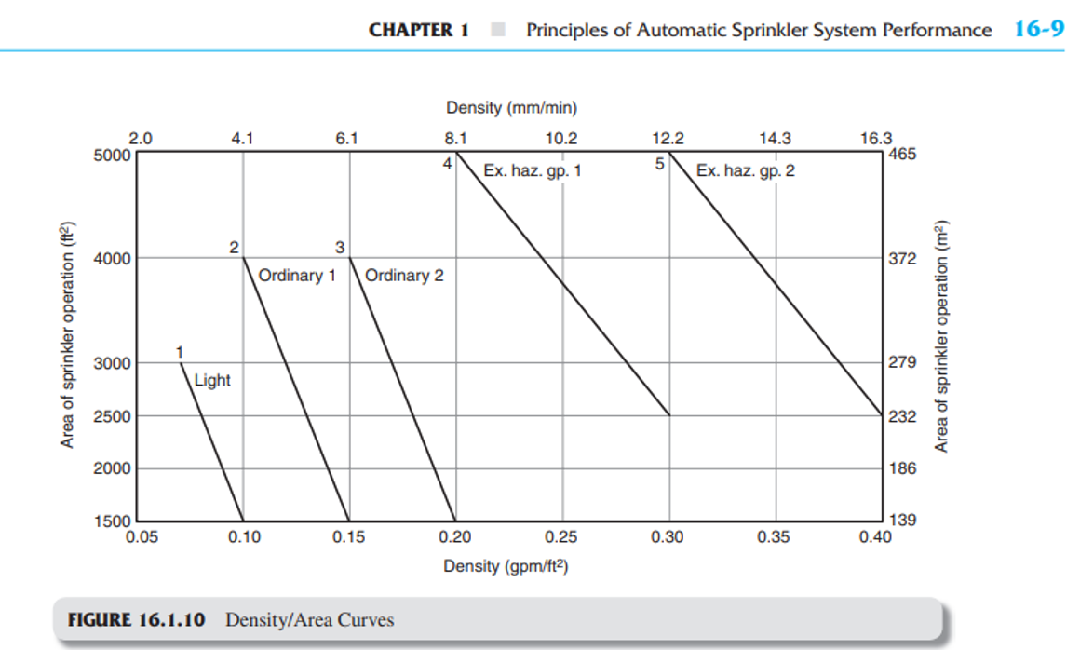
SECTION 16 - Water-Based Fire Suppression Equipment

Slide 27
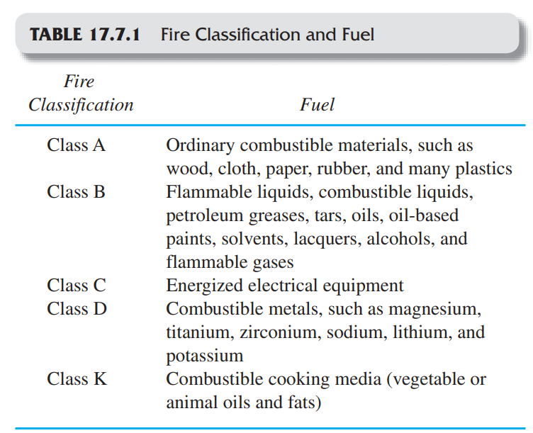
SECTION 17 - Fire Suppression Systems &
Portable Fire Extinguishers

Slide 28
SECTION 18 - Confining Fires
SECTION 19 - Structural Fire Protection

Slide 29
SECTION 20 - Protecting Occupancies

Slide 30
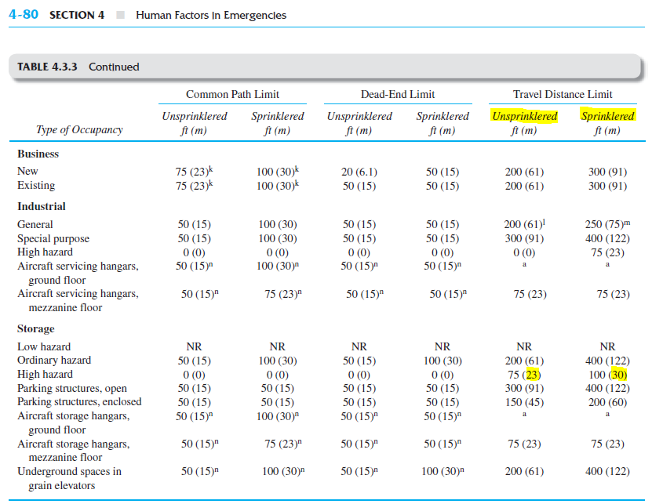
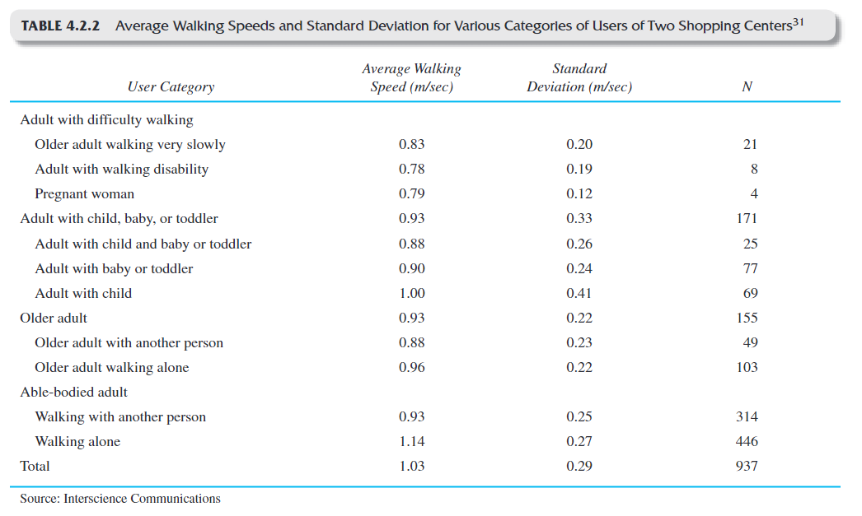


BONUS CRITERIA
NFPA HANDBOOK 20th Ed.
Travel Distance
Walking Speed

Slide 31
THANKS !

