Slide 1
Jetty FireFighting Lines – Stress Analysis
ORNEK STRES ANALİZ RAPORU
Rev. | Date | Prepared By | Checked By | Approved By | Description
0 | 30.04.2019 | B. K. YAVUZ

Slide 2
Index
Introduction
Project Specific Data
Load Cases
Results
Recommendations:
M01, M02, M03, JTH-NT, JTH120, JTH112, JTH111, JTH113, Tees, Fix Supports, Pump Nozzles
Appendices

Slide 3
Introduction
Pipe stress and pump and API610nozzle load analysis for “Jetty Fire Fighting Lines” wrt. ASME B31.3 . The scope is as below:
Double 12in header lines (~ 560 m + 500 m = 1060 m)
5 monitors
14 hydrants
2 pumps
2 PSV tail lines through the sea
2 test lines of pumps through the sea
2 underground lines (~ 30 m)
Fittings (30 reducers, 61 tees, 149 elbows, 280 valves/flanges, 350 supports etc.)

Slide 4
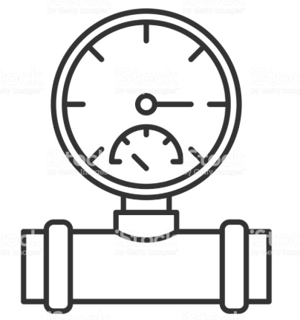
Project Specific Data
Pipe Material : ASME A106 Gr.B (pump PSV, test outlets HDPE DN280x16,6 PN10)
Pipe Wall Thickness : Sch STD
Pipe Mill Tolerance: 12,5% (as per ASME B31.3)
Pipe Corrosion Allowance: 1,59mm (as per ASME B31.3)
Coefficient of friction (μ) : 0.3 (steel to steel)
Product Specific Gravity: 1 SG (Water)
Operating Pressure (incidental): 12 barg (Input of P1 in CAESAR II as PSV set value in the field)
Operating Pressure (max): 11 barg (Input of P2 in CAESAR II as given info)
Hydrotest Pressure: 13,79 barg (Input of HP in CAESAR II)
Operating Temperature (max) : +40°C (Input of T1 in CAESAR II)
Operating Temperature (min) : 0°C (Input of T2 in CAESAR II)
Average Installation Temp. : 21.1°C (70°F) (CAESAR II default value)

Slide 5
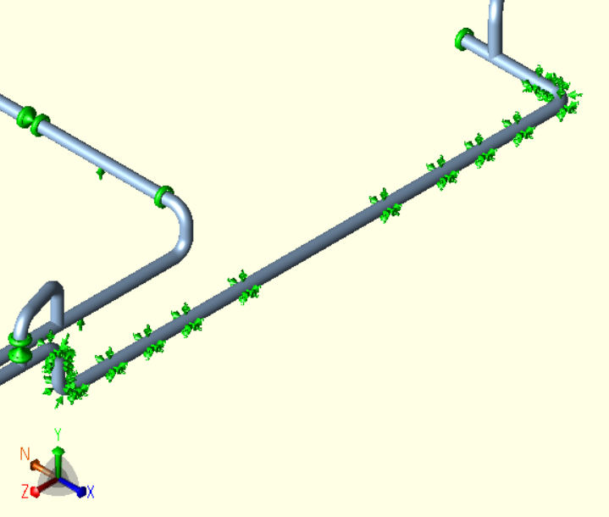
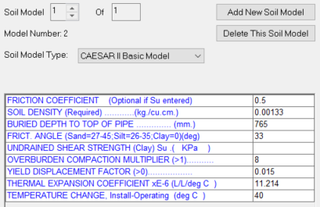
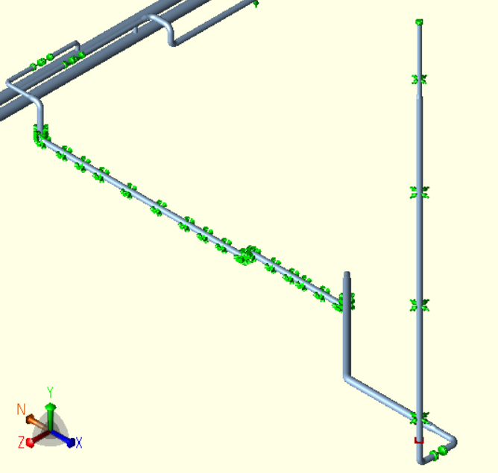
Project Specific Data – Underground Pipe
Underground parts are simulated as bilinear spring model with input parameters as below and with output display as figures at the right.

Slide 6
Load Cases
L1 (HYDrotest) WW+HP Hydrostatic Testing Case = Water Weight + Hydrotest Pressure
L2 (OPErating) W+T1+P1 Hot Operation = Deadweight (incl. Pipe, Fittings, Fluid, etc.) + Max Ope. Temp + Max Pressure
L3 (OPErating) W+T2+P1 Cold Operation = Deadweight + Min Ope. Temp + Max Pressure
L4 (Alt-SUS) W+P1 Alternative of L5 (outputting only stress results)
L5 (SUStained) W+P1 Load experienced by the installation of piping caused by deadweight and max pressure
L6 (EXPansion) L6=L2-L5 Effects of max temperature
L7 (EXPansion) L7=L3-L5 Effects of min temperature
L8 (EXPansion) L8=L2-L3 Cold to Hot expansion case with full expansion stress range, generally worst scenario

Slide 7
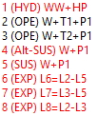
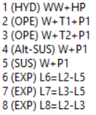
Results
After the analysis of the model, it is observed that 6 of 8 loadcases have overstress on some parts of the lines as per ASME B31.3.
All these overstress problems are resolved with below recommendations and the solution reach to a design without overstress.
Comparison for Loadcase 08 | Allowable | As of .dwg 1212-C (Original Design) | Recommended Design
Max Stress (MPa) | 302 | 924 | 280
Max dX (mm) | - | 122 | -40
Max dY (mm) | - | 14 | -14
Max dZ (mm) | - | 56 | 61

Slide 8
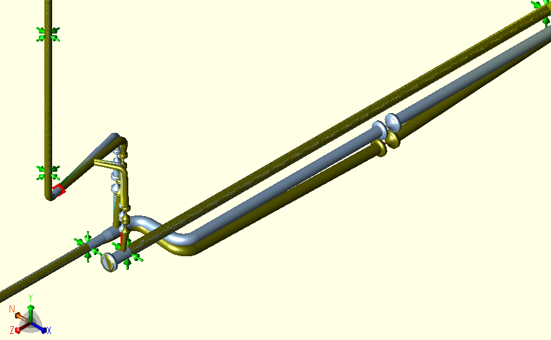
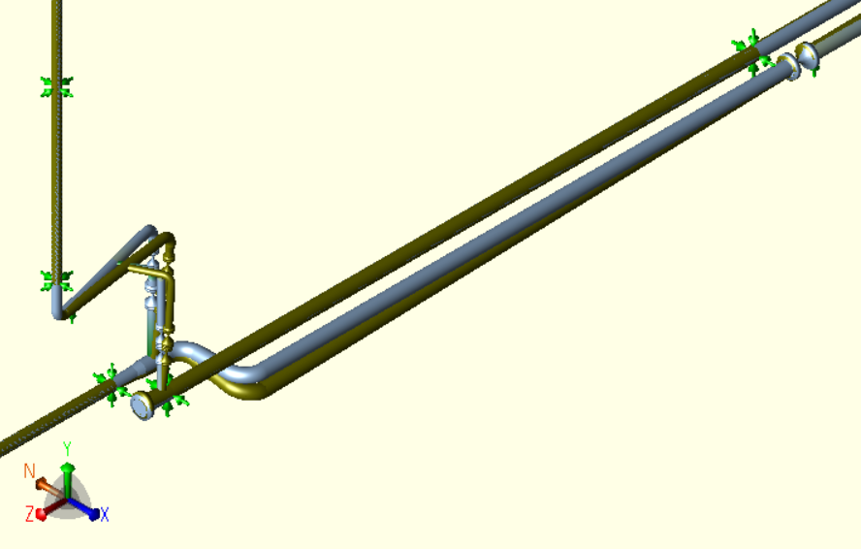
Recommendations 1 – Upstream Valve of M01
The 10" gate valve on the upstream side of M01 should be relocated just over the support or land side of the line.
The fix support before monitör should be replaced with loose support (Y+).
The valve in place has a total weight of 256 kgf with flanges and creates overstress for the tees in downstream.
Above and all deflections in this presentation are shown in brown and with exaggeration factor of 20 (namely 20 times higher).

Slide 9
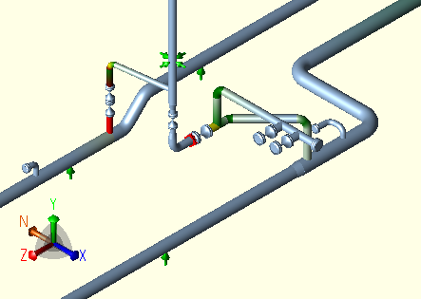
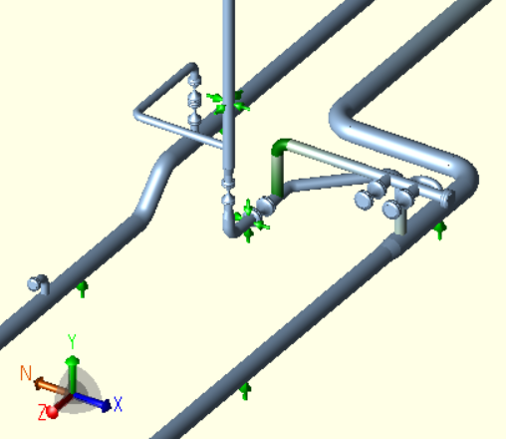
Recommendations 2 – Monitor M02
Branch on the northern header line should be revised including additional elbow to increase flexibility.
The anchor support over the steel construction of monitör should be replaced by a guide support.
The southern header line should be supported with additional restraint.

Slide 10
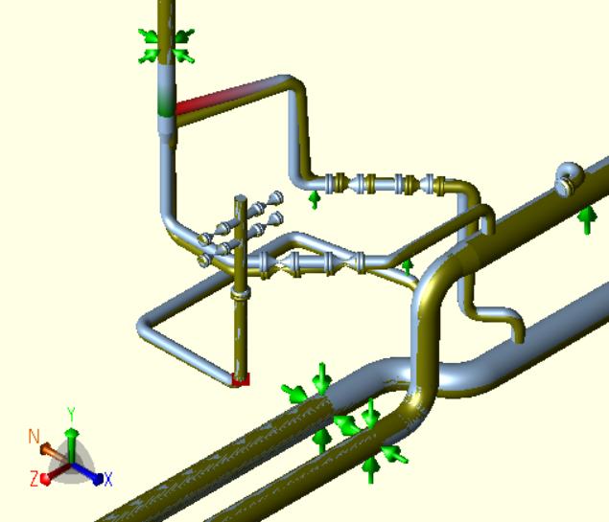
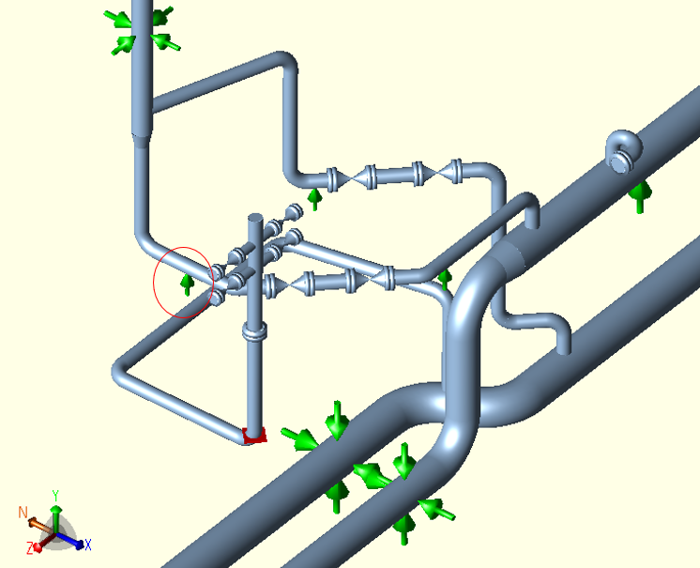
Recommendations 3 – Monitor M03
Additional support in upward position (Y+) should be available under the branches of M03.

Slide 11
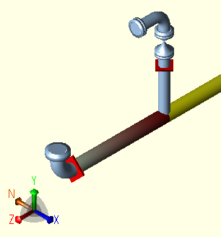
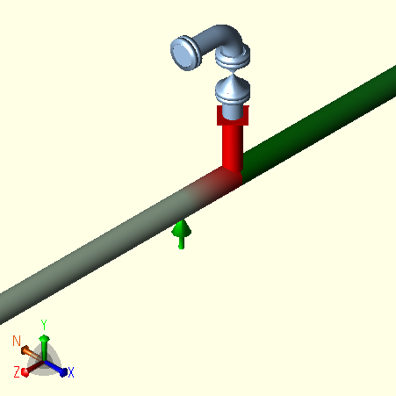
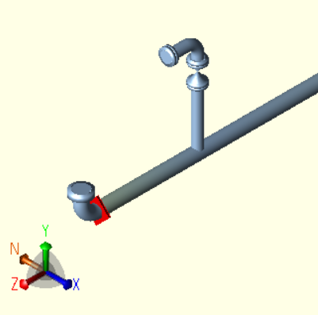
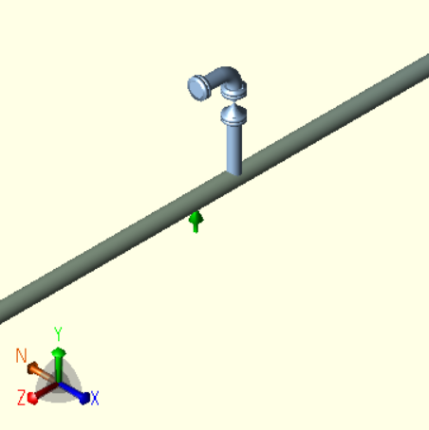
Recommendations 4 – JTH 111 & JTH 112
The fix supports (anchors) on the branches of JTH111 and JTH112 should be removed (or changed to guide type supports).
JTH111
JTH112

Slide 12
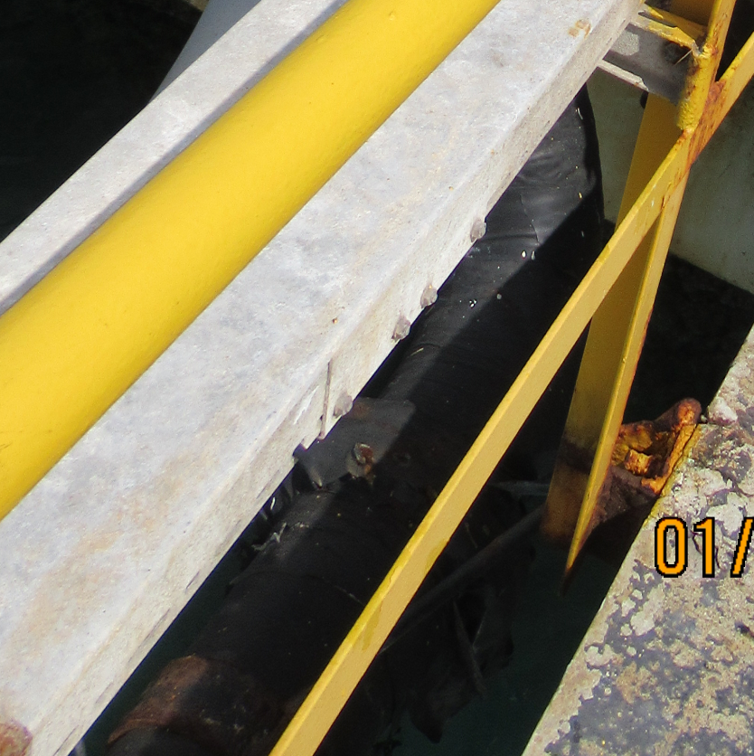
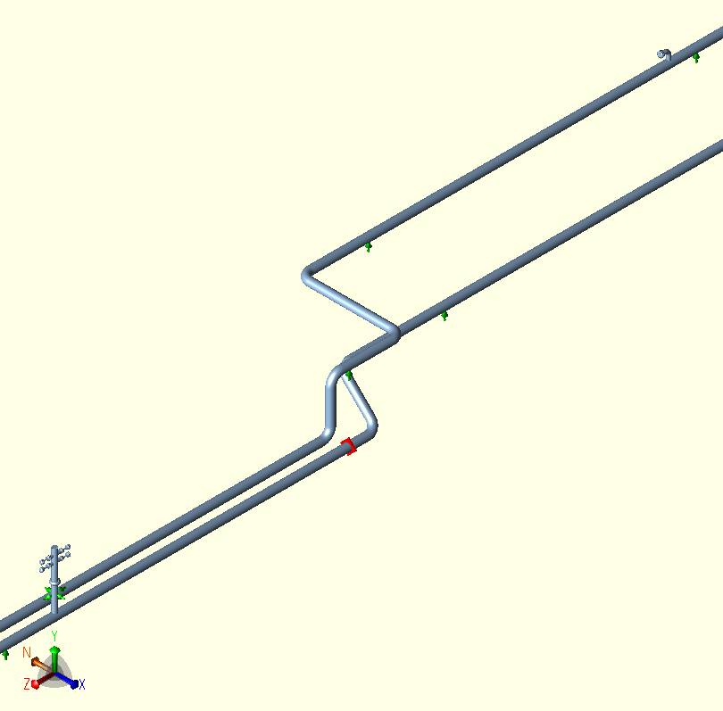
Recommendations 5 – JTH 113
The fix support on the upstream of JTH113 should be repaired with additional measures.
JTH113

Slide 13
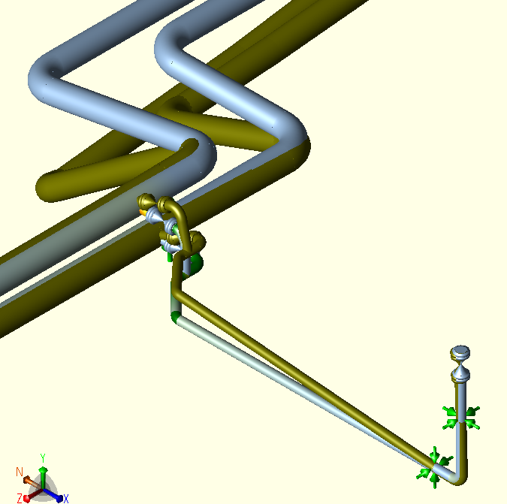
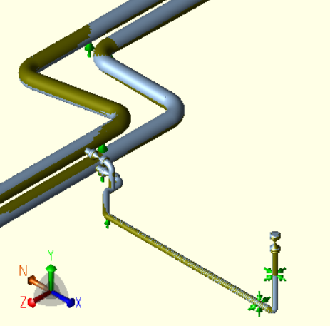
Recommendations 6 – JTH NT
There should be additional loose support for header lines before elbows.
Also there should be additional support for JTH NT which should close to header line.

Slide 14
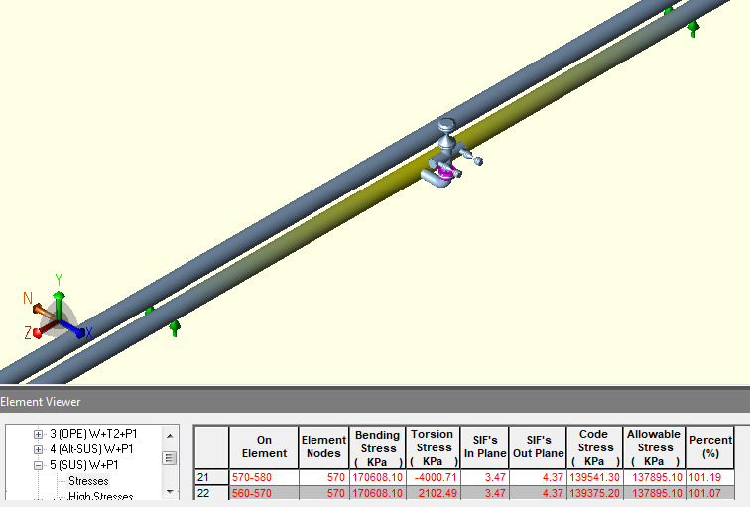
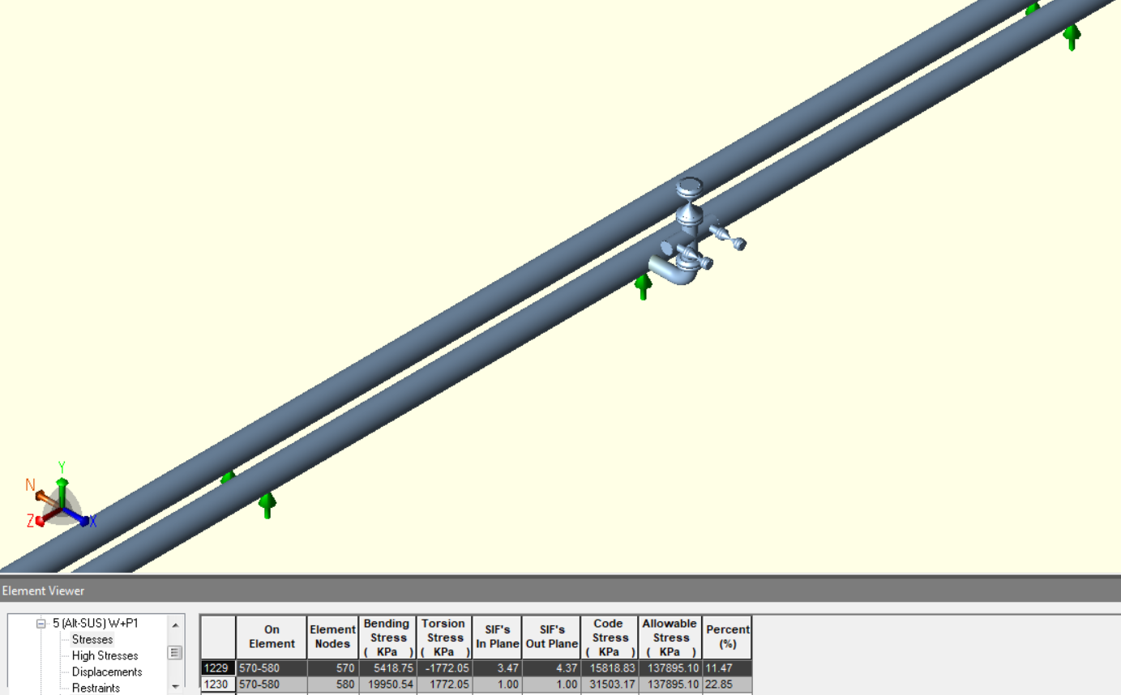
Recommendations 7 – JTH 120
Additional support in upward direction (Y+) should be applied to JTH 120.

Slide 15
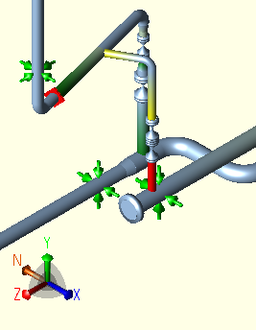
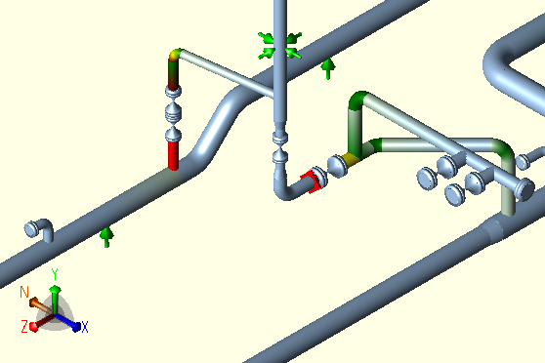
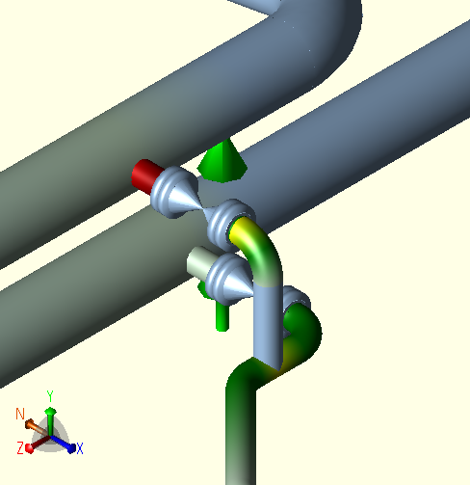
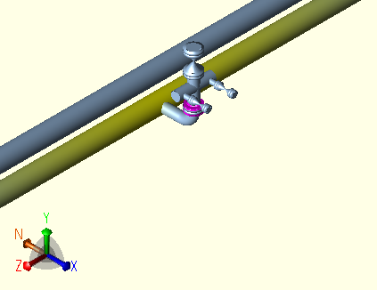
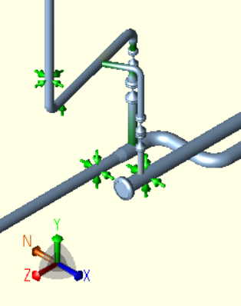
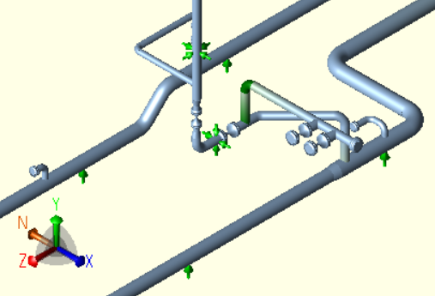
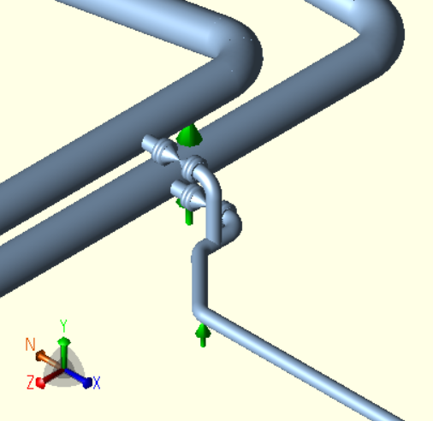
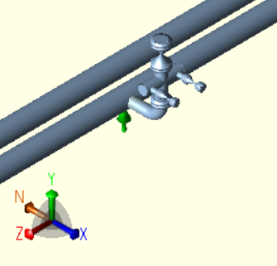
Recommendations 8 – Tees
1. All the tee fittings should be welding or weldolet as per ASME B16.9 instead of unreinforced connections (kurtağzı)
Monitor 01
Monitor 02
JTH-NT
JTH-120

Slide 16
Results – Fix Supports (Anchors)
Given Design in 1212-C.dwg |  | After Revisions
Node Number in Model | Location | New Status | New Type
10, 29220 | Pump nozzle | Remain same
20, 29200 | 2nd fix at pump nozzle | Discussed in following slides
4540 | JTH119 | Remain same
730, 30400 | Header lines | Remain same
4790 | JTH118 | Remain same
5030 | JTH117 | Remain same
5250 | Monitor M4 | Removed | Only upward position (Y+)
5630 | JTH116 | Removed | Guide (X, Z)
6380 | JTH26 | Remain same
1050 | Header line | Removed | Only upward position (Y+)
6660 | Header line (in concrete wall) | Remain same
6740 | Monitor M2 | Removed | Guide (X, Y)
1300 | Header line | Remain same
7400 | JTH113 | Removed | Guide (X, Z)
7700 | Monitor M1 | Removed | Only upward position (Y+)
7900 | JTH112 | Removed | Guide (X, Z)
8000 | JTH111 | Removed | Guide (X, Z)
1500 | Header end | Remain same
The fix supports given in the first drawing is revised as the table at right:

Slide 17
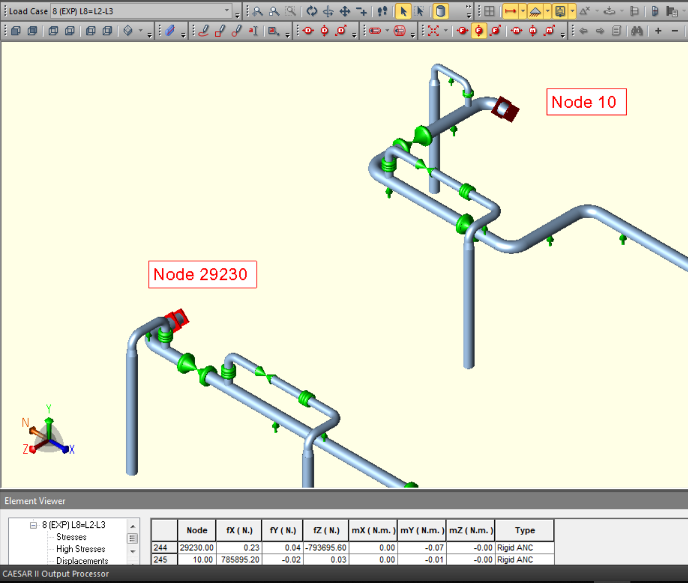
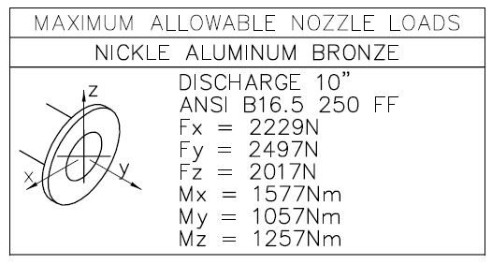
Results Pump Nozzles
Before
The pump nozzle load limits and results of given design in 1212-C are given as right:
Accordingly, axial loads (Fy) are 794 kN and 786 kN for pumps G-2552 and G-2553 subsequenlty while the allowable is approximately 2,5 kN.

Slide 18
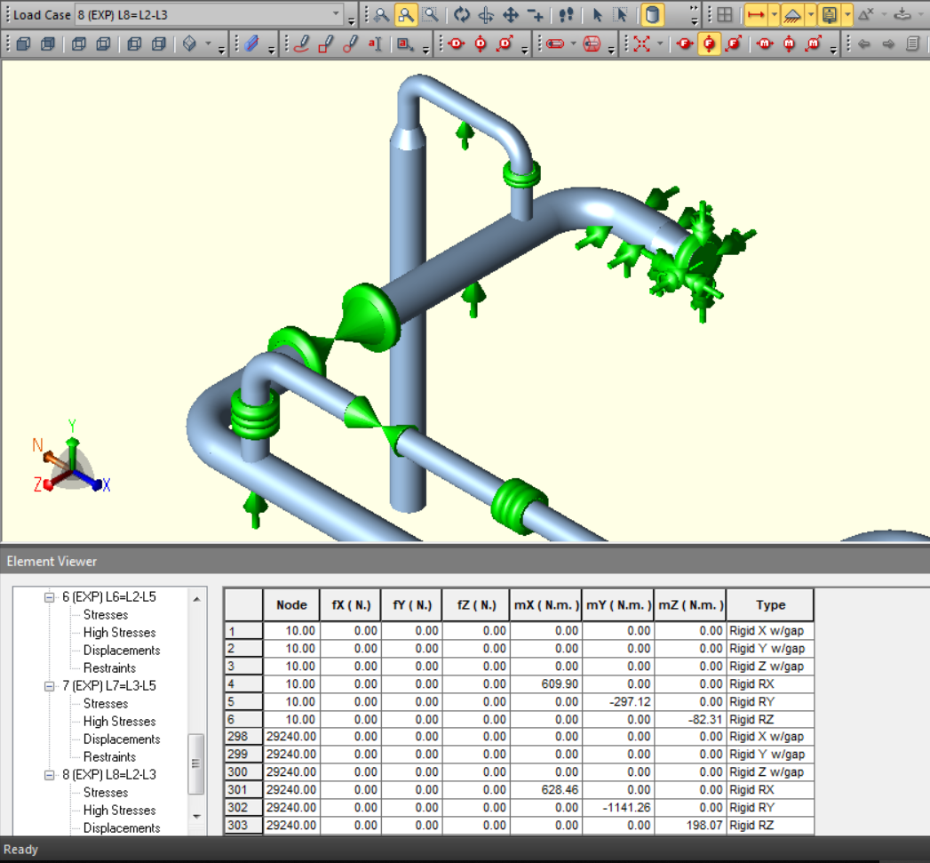
Results Pump Nozzles
After
The results after revisions are given as right.The force and moment values are all within the limits given in the previous slide.
The revisions are:
The main fix support is modelled with displacement allowance of 250 μm given in the API610 Annex F.
2nd fix support is converted to guide support with the length of 360mm.
The stiffness (i.e. 10⁶ N/cm) can be also identified if it is provided by vendor.

Slide 19
THANK YOU!

Slide 20
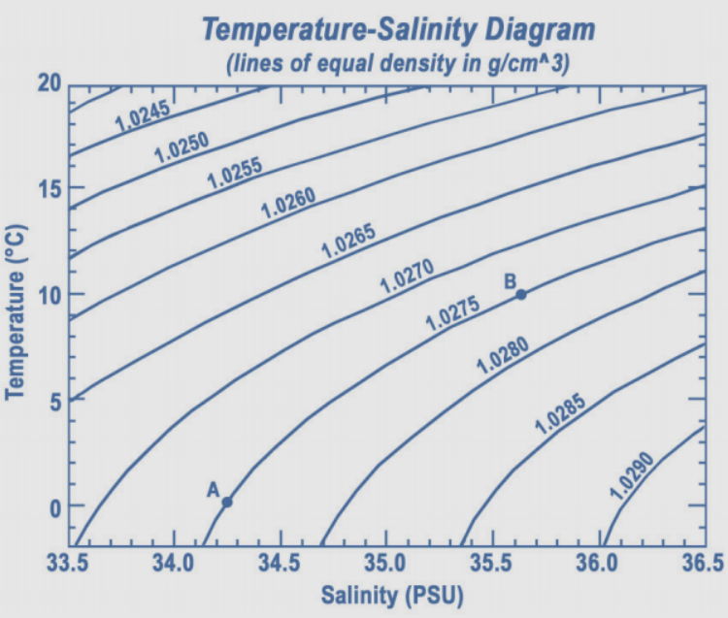
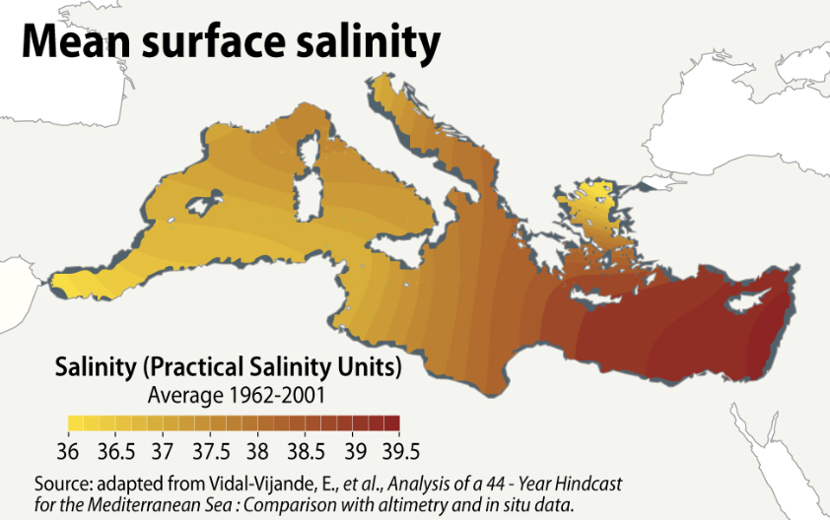
Appendices – 1 – Sea Water Salinity
Sea Water Salinity Diagram

Slide 21
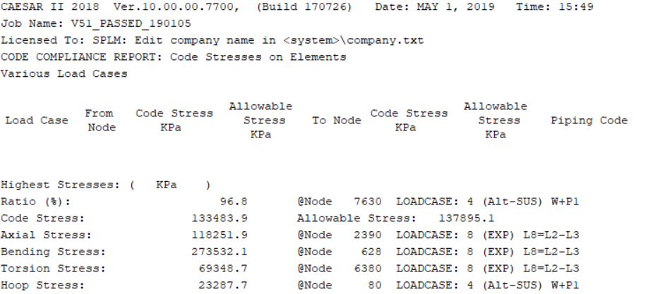
Appendices – 2 – ASME B31.3 Compliance
Code compliance check after recommended design of the lines

Slide 22
Appendices – 3 – API 610 Annex F
Pump shaft displacement limits are given in API 610 Annex F 2010 11th ed. Pg123 as below:

