Slide 1

FREE TO ROLL TESTS
FORCED OSCILLATION TESTS
ROTARY BALANCE TESTS
Mechanical Engineering Department
Bekir Kağan YAVUZ, PhDc
2018913026

Slide 2
Index
Introduction
Wing Rock Phenomenon
Free To Roll Tests
Forced Oscillation Test
Rotary Balance Test
References
Abbreviations

Slide 3
Introduction
The high technology, combat aircrafts has been known to experience control problems during maneuvering at angles of attack, α > 40˚. (Cai et al., 1997).
Wing rock is a highly nonlinear phenomenon in which aircraft undergo near-sinusoidal limit-cycle roll oscillations at a high AoA (Nguyen et al., 1981) which is:
- major maneuver limitation exhibited by modern combar aircrafts (AGARD-AR-155A, 1979) (Levin, D. and Katz, J., 1984)
safety problem in landing (Nguyen et al., 1981)
Also wing rock starts at a lower AoA for a wing with higher sweep.

Slide 4
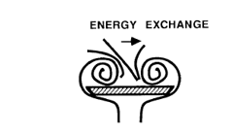
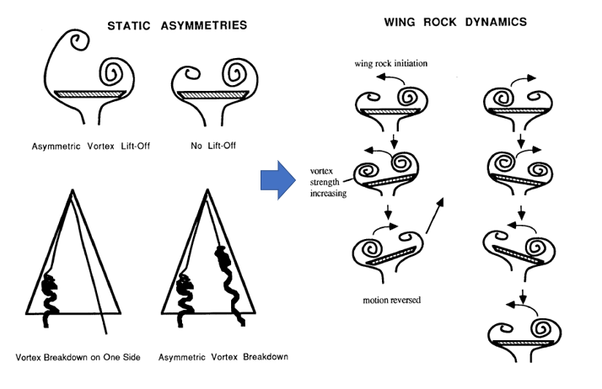
Wing Rock
Reason: Initiated by flowfield asymmetries induced by flow disturbances and vortex interactions near the apex region.
A wing rock test of 6% model of F/A-18C where α = 18˚ (fixed), φmax = -80˚

Slide 5
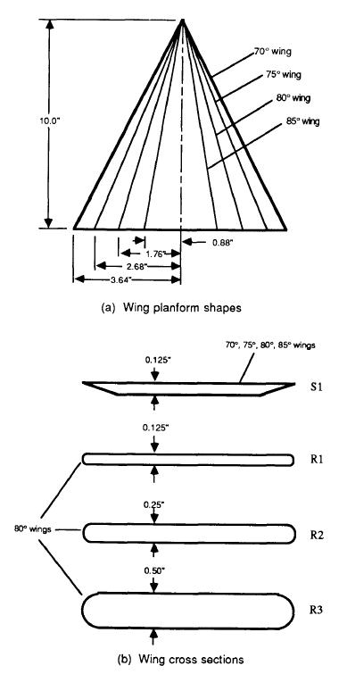
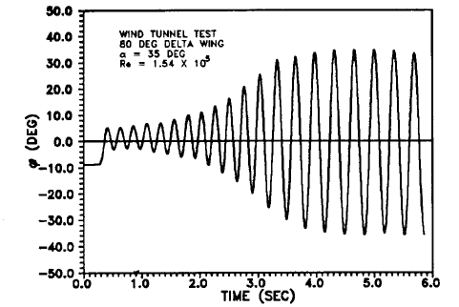
Wing Rock
Typical wing rock response
No Wing Rock cases in literature:
No wing rock observed for 0,5 inch round edge 80˚ wings like R3 in the figure below (Ng, T. & Malcolm, G., 1990):
76˚ wing showed no evidence of wing rock in FTR tests (Levin, D. and Katz, J., 1984).

Slide 6
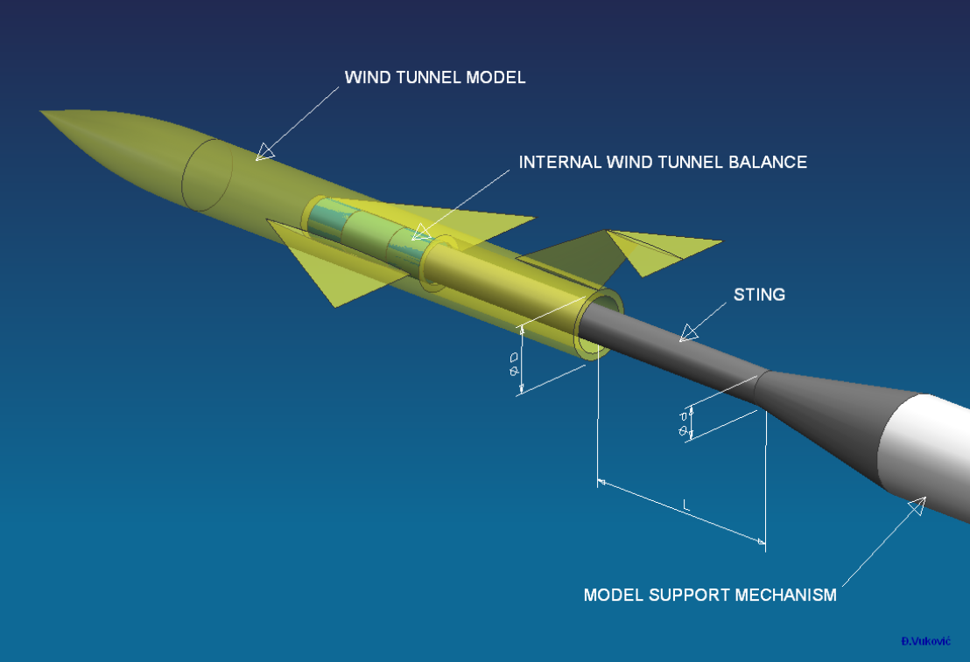
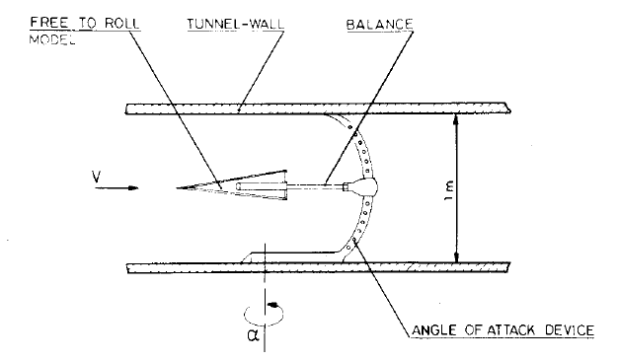
Free to Roll (FTR)
Setup allows a single degree of freedom rolling motion.
The model is statically balanced so that its center of gravity aligned with roll-axis.
The models are sting-mounted consisting of 2 concentric cylindrical barrels attached by ball-bearing assemblies.
This type of experiments are also called self-induced roll oscillations.
Source: Levin, D. and Katz, J., 1984

Slide 7
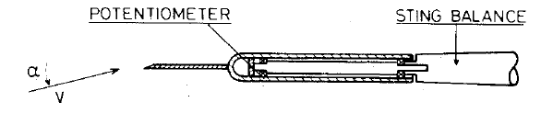
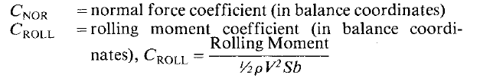
Free to Roll (FTR)
A potentiometer provides continuous information of model roll angle, φ.
A sting-balance mounting is transmitting 3 force and 3 moment components from the model in which electrical signal from the balance could be digitally reduced or analogically plotted versus time, both on a mechanical and on an optical recorder.
Source: Levin, D. and Katz, J., 1984
Where:
b = wing span
S = wing area = (wing span X wing chord)

Slide 8
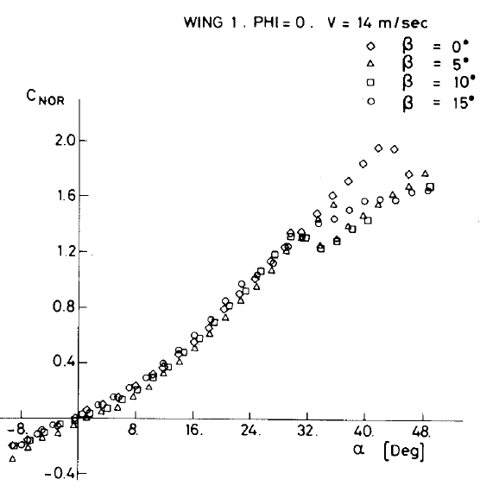
Free to Roll (FTR) Example - 1
Wing stall occurs above α=40˚ for β=0˚, no sideslip case.
Wing stall occurs earlier if there is sideslip.
There are discrepancies mentioned in papers of FTR tests (Nguyen et al., 1981):
The friction in the FTR aparatus (friction difference among test rigs)
The initial moments to induce wing rock are too small for lower AoA to overcome it

Slide 9
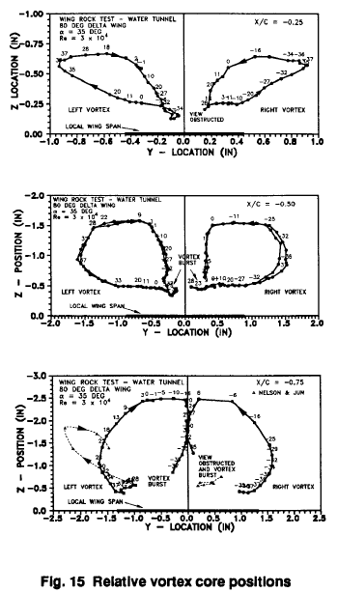
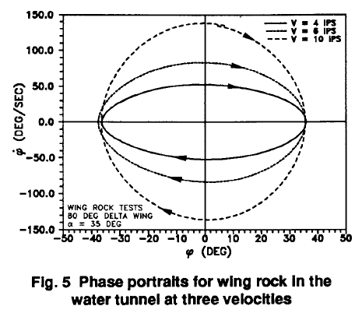
FTR Example -2 (Morris and Ward, 1989)
Water tunnel test (Eidetics):
Video based motion analysis (EV)
Model chord length: 254mm
Slender delta wing (70˚ and 80˚)
Re = 30000 ~ 75000
3 dye ports
Various attack angles = 15˚ ~ 25˚
Sinusoidal motion, amplitude = ± 17,5˚ ~ ± 45˚ (roll angle)
k (reduced frequency): ωb/U = 0,1 , 0,25 , 1
Average oscillation period: 4,55s (~13rpm)
Output:
Relative vortex core positions

Slide 10
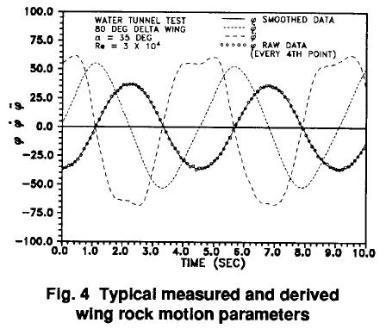
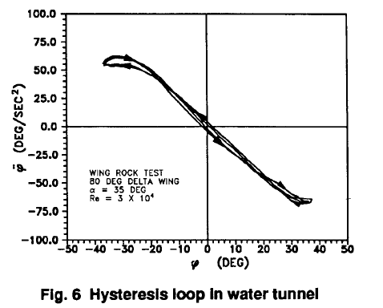
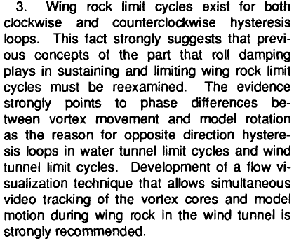
FTR Example -2 (Morris and Ward, 1989) – OUTPUTS
Aim: To analyze the movement of leading-edge vortices during wing rock.
An important result obtained directly from examining the roll acceleration trace (Fig. 4) was that «roll acceleration» was larger after «roll» had passed through its maximum magnitude. This phase difference indicated a hysteresis in «roll acceleration» with «roll» , a phenomenon which continued to appear in the data. Figure 6, with typical data from the same set of runs as Fig. 4, showed the hysteresis loop directly. The two cycles of the nearly periodic trajectory were quite close though they did not coincide.
Conclusion:

Slide 11
Forced Oscillation (FO)
A sinusoidal form of motion is generally used for the FO tests.
The common interests of the tests are vortex trajectory and vortex breakdown.
strongly affected by the oscillation frequency

Slide 12
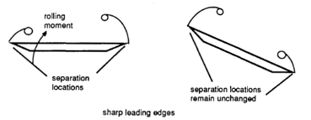
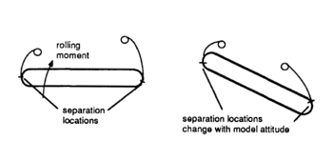
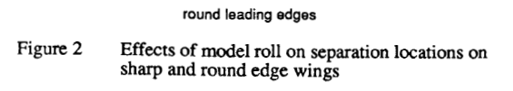
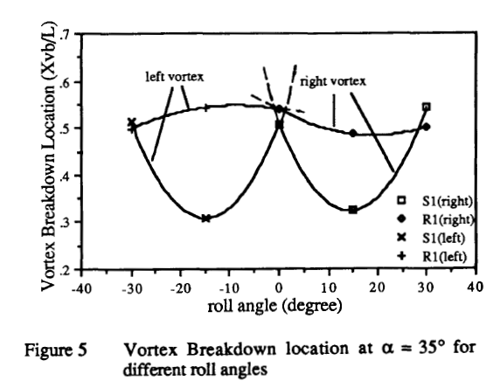
FO Test Example -1 (Ng and Malcolm, 1990)
508x381x1524mm water tunnel test:
Model length: 254mm
Free stream velocity: up to 305mm/s
Brass sting dia: 9,5mm
Re = 8300
Various sweep angle and types (sharp & round)
Various attack angles
Sinusoidal motion, amplitude = ± 17,5 - ± 45 (roll angle)
k (reduced frequency of oscillation): ωb/U = 0,1 or 0,15 (~ 2 rpm)
First, static results are obtained (to be compared afterwards) at right side

Slide 13
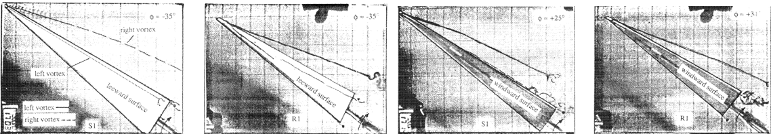
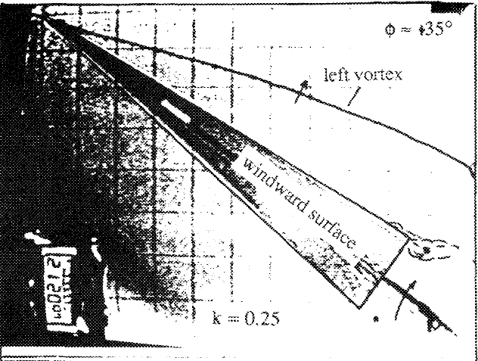
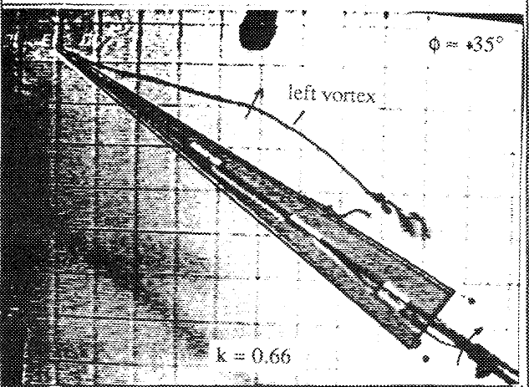
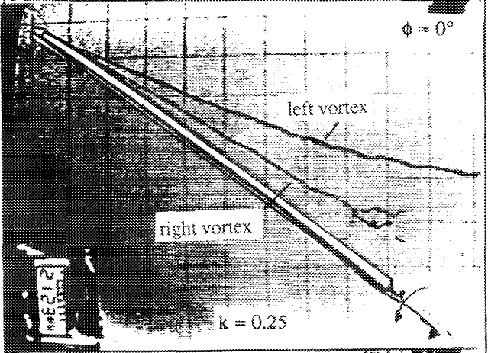
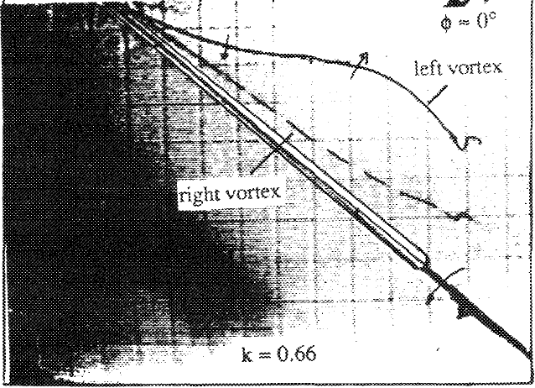
FO Test Example -1 (Ng and Malcolm, 1990) - OUTPUTS
Vortex trajectory and Vortex breakdown location
Compared with the static situation, the initial effect of increasing the oscillation rate is to delay vortex breakdown: k = 0,15 breakdown barely reaches the trailing edge of the R1 wing through the oscillation cycle, and at k = 0,25 the breakdown location moves farther downstream from the trailing edge.
When the oscillation frequency is increased to higher values such as the natural value (k = 0,66), breakdown will propagate back onto the wing and towards the apex.

Slide 14
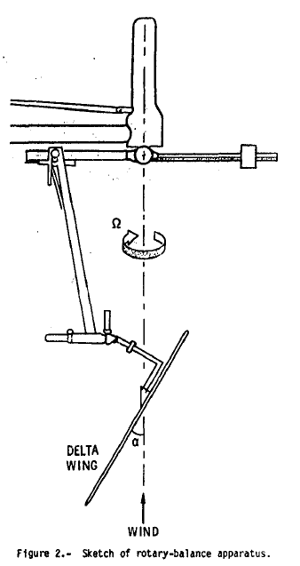




FO Test Example -2 (Nguyen, Yip and Chambers, 1981)
9mt x 18mt Wind tunnel test:
Free stream dyn pressure: up to 0,28 barg
Various sweep angle and types (sharp & round)
Various attack angles = 0˚ ~ 40˚
Zero sideslip
Sinusoidal motion, amplitude = ± 5 , ± 10 , ± 29 (roll angle)
k (reduced frequency): ωb/U = 0,06 , 0,09 , 0,12
Remark: major factor producing wing rock is loss of damping
Damping in roll parameter:
C_{l}: Rolling moment coefficient,
Where Ix: roll inertia of the model experimentally determined
q: free stream dynamic pressure
S: wing area
b: wing span
φ(t1): roll angle at the time

Slide 15
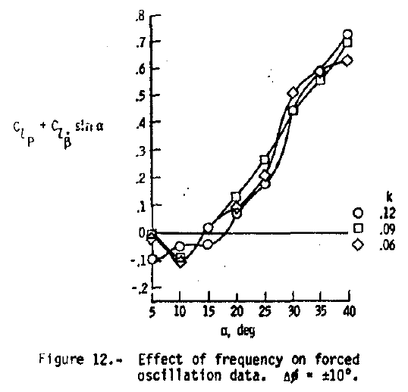
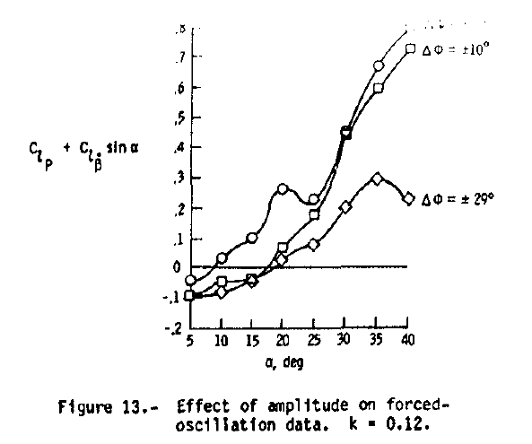
FO Test Example -2 (Nguyen, Yip and Chambers, 1981) - OUTPUTS
Roll damping parameters vs α
FO tests frequencies are lower than FO results (0,22) due to equipment limitations
The roll damping characteristics of the wing are not strongly dependent on the frequency of the oscillation
Positive (stable) damping is exhibited at low angles of attack followed by a loss in roll damping beginning at moderate angles of attack such that positive (unstable) valuer of are exhibited for α > 18.

Slide 16
Rotary Balance
Rotary balance is a technique for measuring forces under dynamic conditions in a tunnel/channel. The rotary balance drives the model relative to the airstream and measures the resulting forces on the model (Tuttle, H., 1989).
RBT data is used to identify spin* modes of aircraft, but it does not provide a database for nonspinning maneuvers, because the test conditions closely approximate aircraft spin motions. In rotary balance test, the model is rotated at a constant rate about free stream velocity vector (roll) (Kalviste, J., 1982).
The test video conducted in 1960 at NASA Langley Research Center’s
4,8mt Transonic Dynamics Tunnel, the B-58 aircraft model was 1/40 scale
β=12˚, α=90˚-80˚-70˚-60˚, rpm=170-340
Notes:
* A spin is more complex, involving intentionally stalling a single wing, causing the plane to descend spiraling around its yaw axis in a corkscrew (tirbüşon) motion.

Slide 17
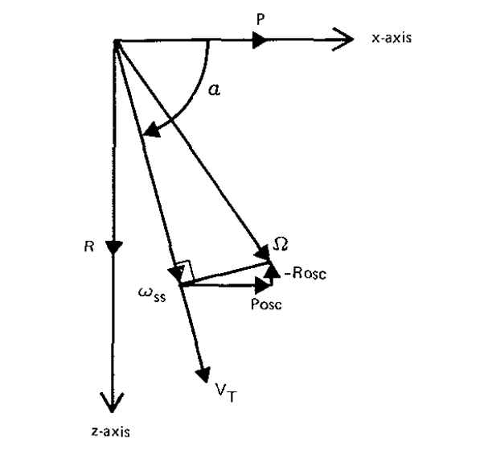
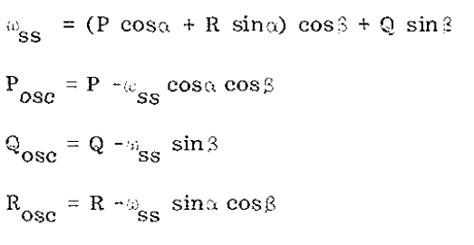
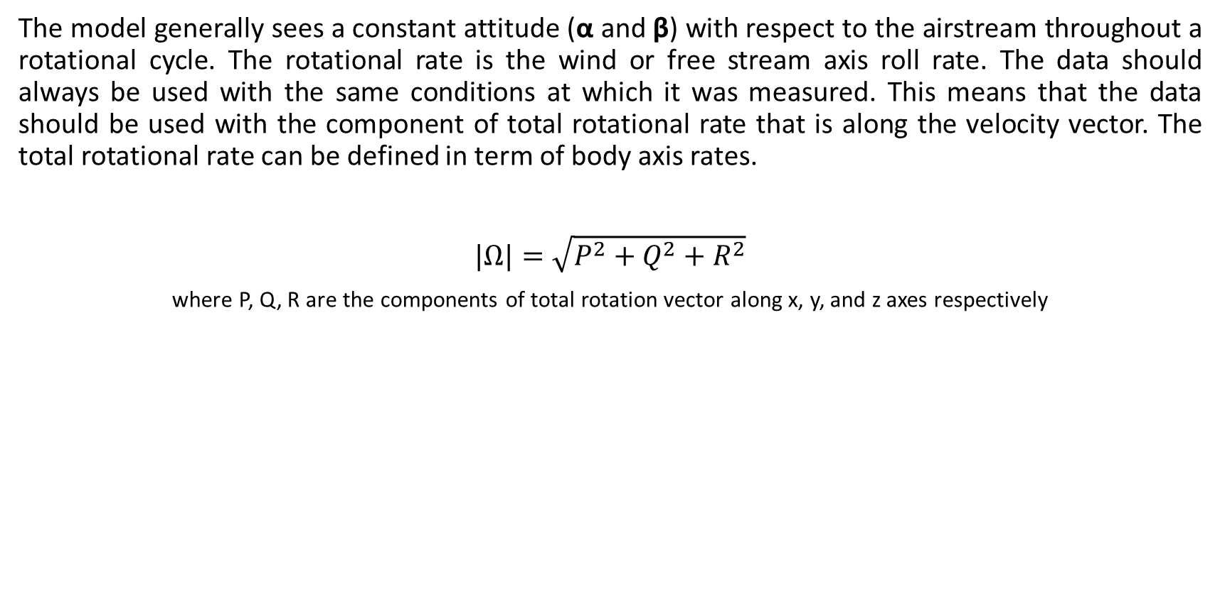
Rotary Balance
The model generally sees a constant attitude (α and β) with respect to the airstream throughout a rotational cycle. The rotational rate is the wind or free stream axis roll rate. The data should always be used with the same conditions at which it was measured. This means that the data should be used with the component of total rotational rate that is along the velocity vector. The total rotational rate can be defined in term of body axis rates.
$|Ω|=\sqrt{P^{2}+Q^{2}+R^{2}}$
where P, Q, R are the components of total rotation vector along x, y, and z axes respectively

Slide 18
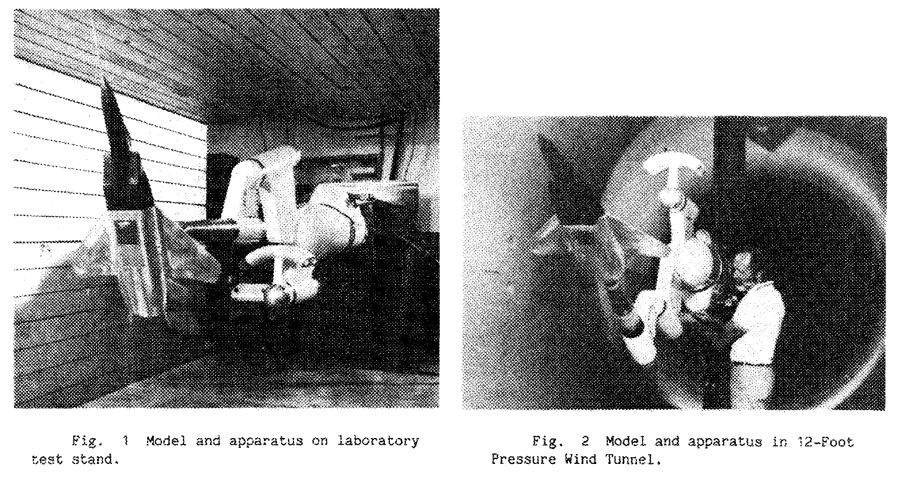
Rotary Balance Test Example -1 (Malcolm N. G., 1985)
3,6mt wind tunnel test:
1/20 scale F-15
P = up to 5atm
Re chord=5,5x10⁶
Rpm= up to 350
Dynamic moment=45,2kN.m
Strain Gages = 50mm (6 Component)
Tachometer for spin rate

Slide 19
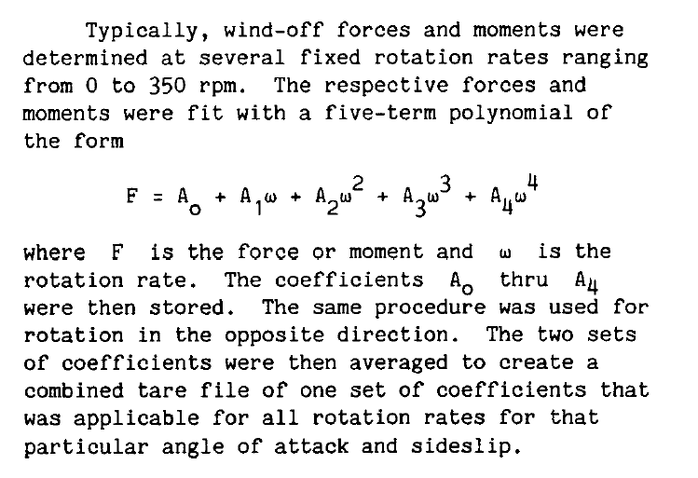
Rotary Balance Test Example -1 (Malcolm N. G., 1985)
«Tare» Loads:
Outputs:
Normal force coefficient, C_{N}
Pithcing moment coefficient, C_{m}
Yawing moment coefficient, C_{n}
Rolling moment coefficient, C_{l}
wrt.
Angle of attack, α
Rotation rate (nondimensional), ωb/2V
(where b: span, V: free stream velocity)

Slide 20
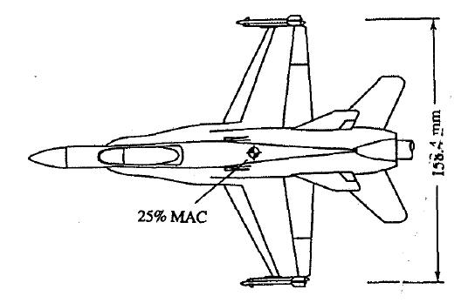
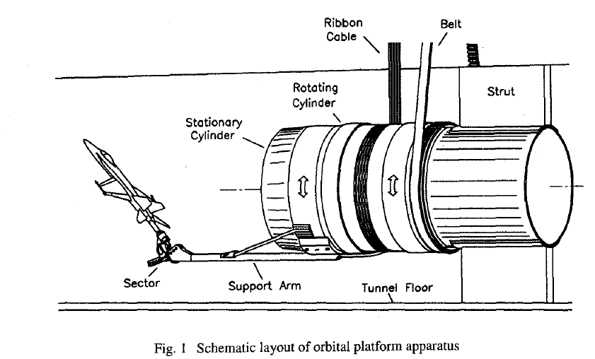
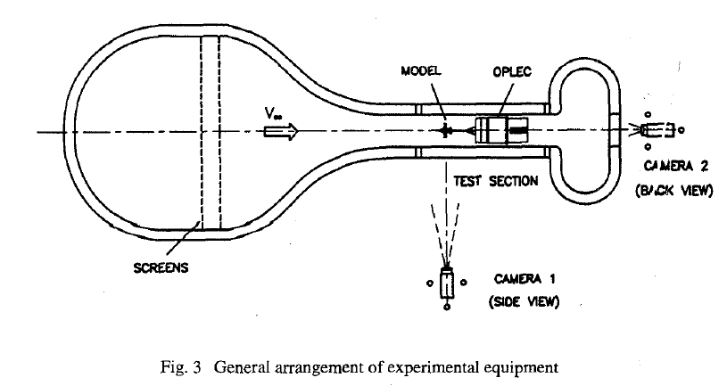
Rotary Balance Test Example -2 (Cai et al., 1997)
380 x 510 mm water tunnel test:
Δu/U_{ꚙ} <1%, 22˚C
1/72 scale F/A-18
Free stream velocity: 0,13~0,37m/s
Re_{chord} = 6460~17800
Flow visualization: 12 dye ports
Semi Conductor 5 Strain Gages: 5 component, sensitivity: 1g-130g
Rotation Rate: ωb/2U_{ꚙ} = ±0,3 (where ω or Ớ is coning rate)
Notes:
5-component balances: the axial force component omitted

Slide 21
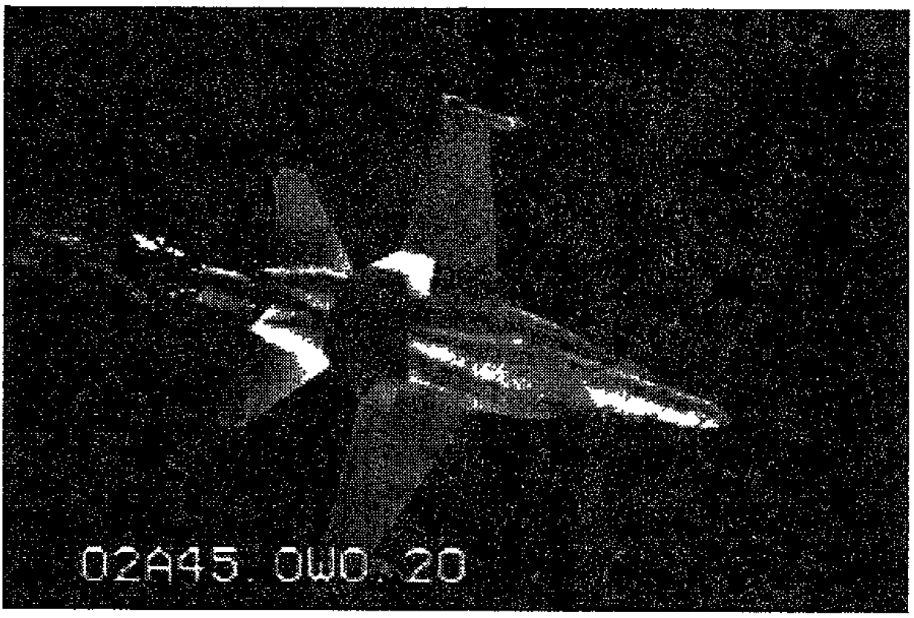
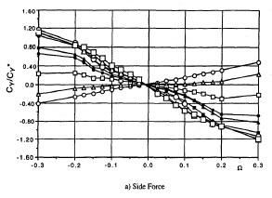
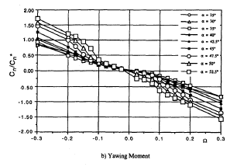
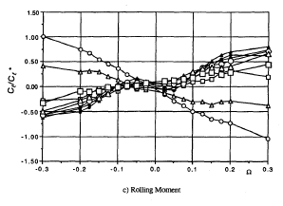
Rotary Balance Test Example -2 (Cai et al., 1997) - Outputs
Outputs:
Dye Visualization: Vortex breakdown location
  The effect of rotation on the lifted vortex, and the delay in vortex breakdown on the leeward LEX as compared with the windward side.
Rotary Balance
  The force and moment data are plotted as functions of rotation rate, Ω. The aerodynamic coefficients are normalized with respect to a common set of values, Cy*, Cn*, Cl*.
  The angle of attack range: 25˚ < α < 65˚. The angle of attack increment was generally Δα = 2.5˚ and the reduced rate increment at low rates was ΔΩ = 0.025.
  At α = 55˚ the nonlinearity increases, and at higher α the lateral directional aerodynamics become multi-valued.
Notes:
5-component balances: the axial force component omitted

Slide 22
Q & A
THANK YOU!

Slide 23
References
Cai, H.J., Beyers, M.E. and O’Hagan, S., "An Orbital Platform Rotary Balance System For The Iar Water Tunnel", Institute for Aerospace Research National Research Council of Canada, 1997.
Kalviste, J., "Use Of Rotary Balance And Forced Oscillation Test Data In Six Degrees Of Freedom Simulation", AIAA-82-1364 AIAA 9th Atmospheric Flight Mechanics Conference, August 9-11, 1982.
Levin, D. and Katz, J., "Dynamic Load Measurements with Delta Wings Undergoing Self-Induced Roll-Oscillations", Journal of Aircraft, Vol. 21, pp. 30-36, Jan. 1984.
Malcolm, G. N., "Rotary-balance Experiments On A Modern Fighter Aircraft Configuration At High Reynolds Numbers" NASA Ames Research Center, Moffett Field, California, 1829, 1985
Manoeuvre Limitations of Combat Aircraft, AGARD-AR-155A. August, 1979.
Morris, S.T. and Ward, D.T., «A Video-based Experimental Investigation Of Wing Rock», Texas AIM University, College Station, Texas, 89-3349-CP, 1989
Ng, T. And Malcolm, N.G, «Effect Of Leading Edge Roundness On A Delta Wing In Wing-rock Motion», AIAA-90-3080-CP, 1990
Nguyen, L.E., Yip, L.P., and Chambers, J.R., "Self Induced Wing Rock of Slender Delta Wings" AIAA Paper 81-1883, August 1981
Tuttle, H., Kilgore, A., and Sych, L., "Rotary Balances A Selected, Annotated Bibliography", NASA Technical Memorandum 4105, 1989.

Slide 24
Abrreviations
AoA: Angle of attack
C_{N}: Normal force coefficient
C_{m}: Pithcing moment coefficient
C_{n}: Yawing moment coefficient
C_{l}: Rolling moment coefficient
RB: Rotary balance
FtR: Free to roll
FO: Forced oscillation
V: Free stream velocity

